Slide 1
An Orthodox Theology of Baptism
An Exegesis of Baptism from the liturgical & patristic tradition

Slide 2
Some Preliminaries
Baptism today is a sacrament that can be performed any time in the year. It is no longer attached to the liturgy of great feasts.
It is no longer attached to ANY liturgy!
It is no longer a sacrament of the gathered church, but rather a private celebration.
It is most commonly performed on infants.
The present baptismal service combines two services that were originally separate.

Slide 3
Basic Questions

Slide 4
All Christians have been called by God. His call to them originated in the proclamation to them of the gospel, and their acceptance of it was signed and sealed in their acceptance of baptism. This was the normal sequence in NT and early church. A dramatic example is the Philippian jailer in Acts 16. But the service of baptism testifies to an equally valid tradition – that the one being baptized will hear the gospel of salvation and faith!

Slide 5
The Didache (late 1st century or early 2nd century)
And concerning baptism, baptize this way: Having first said all these things (reference to pre-baptismal instruction), baptize into the name of the Father, and of the Son, and of the Holy Spirit, in living water (ὕδωρ ζῶν).
John 4:10 “If you knew the gift of God, and who it is that is saying to you, ‘Give me a drink,’ you would have asked him, and he would have given you living water (ὕδωρ ζῶν).”
Pentecostarion When the Lord came to the well of Jacob, the Samaritan woman entreated him, saying: “Give me the water of faith, O Giver of Life, that I may obtain the waters of baptism, joy, and salvation.” O Lord, glory to you!
Pentecostarion Jesus went up to the Temple in the middle of the feast. He proclaimed: Let all who thirst come to me and drink. I will give them the water of life, and they will never thirst again. Living streams will flow from the hearts of those who believe in me. They will find the light of the world. (John 7:39 – by this he meant the Spirit.)

Slide 6
The Didache
But if you have no living water, baptize into other water; and if you cannot do so in cold water, do so in warm. But if you have neither, pour out water three times upon the head into the name of Father and Son and Holy Spirit. But before the baptism let the baptizer fast, and the baptized, and whoever else can; but you shall order the baptized to fast one or two days before.
The word βαπτίζω in the NT has no liturgical connotation. It simply means “to immerse” – and this was the way people were baptized, by immersion in water. In Acts 8:38-39 Philip and the Ethiopian official both descended into the water for the baptism of the Ethiopian. The Didache provides very early witness that the mechanics of baptism were easily adaptable to circumstances.

Slide 7
The Apostolic Tradition of Hippolytus (3rd century) Concerning Baptism
Thus he descends into the waters; the presbyter places his hand on his head and questions him, saying, “Do you believe in God the Father Almighty?” He who is baptized replies, “I believe.” Then he immerses him in the water once, his hand on his head.
He questions him a second time, saying, “Do you believe in Jesus Christ, Son of God, whom the virgin Mary bore by the Holy Spirit, who came for the salvation of the human race, who was crucified in the time of Pontius Pilate, who died and was raised from the dead the third day, ascended into heaven, is seated at the right hand of the Father, and will come to judge the living and the dead?” He replies, “I believe.” Then he immerses him in the water a second time.
He questions him a third time, saying, “Do you believe in the Holy Spirit, the Paraclete flowing from the Father and the Son?” When he replies, “I believe,” he immerses him a third time in the water. And he says each time, “I baptize you in the name of the Father, of the Son, and of the Holy Spirit, equal Trinity.”

Slide 8
Prayers at the Making of Catechumens
This first part of the baptism service is all that remains of what used to be a very extensive preparation for baptism, when candidates for baptism, called catechumens, were progressively introduced into the life of the church by special rites, which included exorcisms, prayers, explanations of holy scriptures, etc. This preparation involved the entire community, which thus was preparing itself for the reception of the new members. Today, the godparent has replaced the community! And baptism has been trivialized.

Slide 9
St. Cyril of Jerusalem (4th century) You were led down to the font of holy baptism just as Christ was taken down from the cross and placed in the tomb which is before your eyes. Each of you was asked: “Do you believe in the name of the Father and of the Son and of the Holy Spirit?” You made the profession of faith that brings salvation, you were plunged into the water, and three times you rose again.
My spirit is the Holy Spirit’s.
Therefore I believe and confess my faith,
which is the source of light and life to me.
Blessed Father, I, your creature,
would have you make me holy like yourself,
for you have given me every means to become so.
From a 2nd-century papyrus

Slide 10
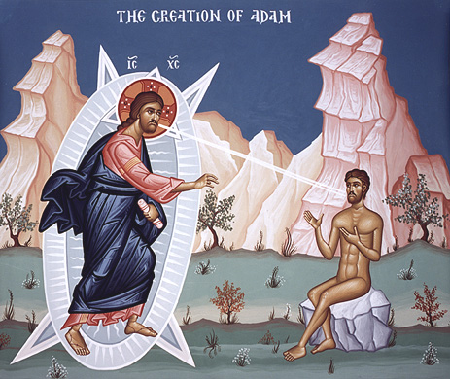
Opening Prayer
Breathing three times, “In the name of the Father…”
“I lay my hand on your servant… who seeks refuge in your holy name…”
“Banish from him/her the ancient error…”
“Inscribe his/her name in your book of life…”
3-fold breathing upon the candidate for baptism is reminiscent of God’s breathing life into Adam

Slide 11
Three Exorcisms follow
Satan is rebuked and commanded to depart.
Satan’s defeat by Christ at the resurrection and in the final second coming is invoked several times to shame & mock Satan.
Threefold breathing on the candidate to expel all evil spirits so that he/she may become an honorable member of the church. (Contrast purpose of this breathing to the previous 3-fold breathing. God’s breath is powerful to create and destroy!) This entire first part of the service seems to echo the creation and fall of man.

Slide 12
Profession of faith
Renunciation of Satan & spitting on him - facing “West”
Commitment to Christ – facing “East”
Nicene Creed
Bow and worship the Trinity
Prayer of entrance into church
Call to “holy illumination” and gift of baptism; call to removal of old nature and filling with power of the Holy Spirit & union with Christ.

Slide 13
St. Gregory of Nyssa (4th century) Faith is the womb that conceives this new life, baptism the rebirth by which it is brought forth into the light of day. The church is its nurse, her teachings are its milk, the bread from heaven is its food. It is brought to maturity by the practice of virtue: It is wedded to wisdom; it gives birth to hope. Its home is the kingdom; its rich inheritance the joys of paradise; its end, not death but the blessed and everlasting life…
St. John Chrysostom (4th century) Will you allow me now to address some words to your sponsors…? They should not consider that what they are doing is a routine action. Rather they should be fully aware that they will share the credit if they guide their charges to the path of virtue by their advice, but that if they are negligent, then grave condemnation will fall upon them. For this reason it is the custom to call them “spiritual parents,” in order that they may learn from their office the affection they owe to their charges in giving them spiritual instruction.

Slide 14
The Sacrament of Baptism
“Blessed is the kingdom….”
The Great Litany
For the sanctification of the water
For the person to be baptized – to be born/grow into (σύμφυτον) and partake (κοινωνόν) of the death and resurrection of Christ: key concept!
For the washing and remission of sins

Slide 15
Prayer Over the Water
Magnificent remembrance of God’s creative and sanctifying acts – cf. Great Agiasmos
“For you… could not endure to see the human race under the tyranny of the Devil, but you came and saved us… You have set at liberty the generations of our nature…
“You hallowed the streams of Jordan, sending down from the Heavens Your Holy Spirit, and crushed the heads of dragons that lurked therein.”

Slide 16
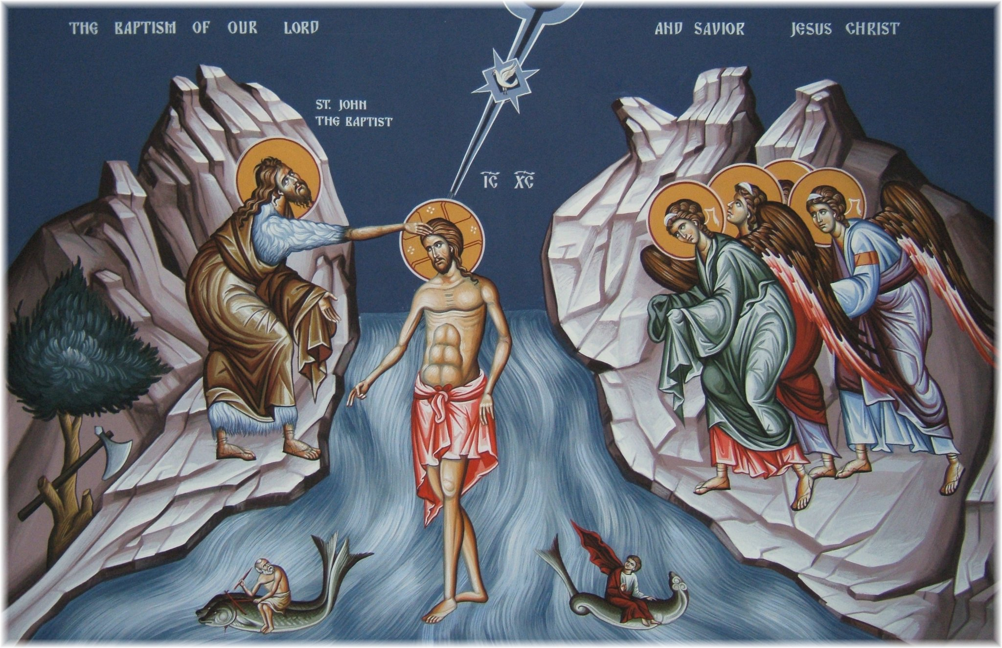
Dragons in the Jordan (Baptism of Christ)

Slide 17
“Let all adverse powers be crushed beneath the signing of your most precious cross.”
“O Master of All, show (ανάδειξον) this water to be water of redemption, water of sanctification, a cleansing of flesh and spirit, a loosing of bonds, a forgiveness of sins, an illumination of soul, a laver of regeneration, a renewal of the spirit, a gift of adoption, a garment of incorruption, a fountain of life.”
“… put away the old man (άνθρωπον)… put on the new…”
that the person to be baptized be “planted in the likeness of [Christ’s] death through baptism [and] become partaker of [Christ’s] resurrection.”

Slide 18
Christ’s Death and Resurrection
Adherence to the crucified Christ takes place in baptism “into his death.” There, in the baptismal burial of believers is shown the power of the Spirit to provide life and resurrection – freedom from sin and all its consequences. There, in baptism, which is acceptance of the gospel of Christ, is communicated the Spirit whom God supplies. This is the same Spirit by whom Jesus was raised from the dead. This is the heart of the gospel: “the gospel concerning his Son, who was descended from David according to the flesh and was declared to be Son of God with power according to the spirit of holiness by resurrection from the dead, Jesus Christ our Lord” (Romans 1:3-4). This half-sentence is just about as good a summary of the gospel as anything else in the New Testament!

Slide 19
Anointing with Oil of Gladness
“Blessed is God who enlightens and sanctifies everyone who comes into the world.”
“…to hear the words of faith… to see the glory of God and speak of his wonders… Your hands, Lord, made him and fashioned her to walk in your commandments… Whoever wishes to follow Christ, let him deny himself and take up his cross and follow Christ.”
Baptism by threefold immersion with the Trinitarian formula commanded by Christ

Slide 20
Psalm 31(32) – David’s prayer of thanks to God after his sins were forgiven is read immediately after baptism
Prayer of Chrismation (Confirmation)
“… you gave us blessed cleansing through baptism and divine sanctification through life-giving chrismation… well-pleased to give new birth through water and the spirit and remission of all his/her sins, both voluntary and involuntary…”
Chrismation
“The seal of the gift of the Holy Spirit.”

Slide 21
St. Cyril of Jerusalem (4th century) But be sure not to regard the chrism merely as ointment. Just as the bread of the eucharist after the invocation of the Holy Spirit is no longer just bread, but the body of Christ, so the holy chrism after the invocation is no longer ordinary ointment but Christ’s grace, which through the presence of the Holy Spirit instills his divinity into us. It is applied to your forehead and organs of sense with symbolic meaning; the body is anointed with visible ointment, and the soul is sanctified by the holy, hidden Spirit.

Slide 22
The White Garment
“Clothed is the servant of God (Name) with the garment of righteousness, in the Name of the Father…”
Hymn: “A robe of light bestow upon me, O You who clothe yourself with light as a garment, O Christ our God of many mercies.”
Colossians 3:12-14 As God’s chosen ones, holy and beloved, clothe yourselves with compassion, kindness, humility, meekness, and patience. Bear with one another and, if anyone has a complaint against another, forgive each other; just as the Lord has forgiven you, so you also must forgive. Above all, clothe yourselves with love, which binds everything together in perfect harmony.

Slide 23
The Procession
In early centuries, this was the entrance of the newly baptized into the main church to join the worshipping community (as in the Paschal vigil) and participate in Eucharist for first time
Today, this is a walk around the baptismal font.
Hymn: “As many as have been baptized into Christ, have put on Christ. Alleluia.”

Slide 24
Galatians 3:27-28 “As many of you as were baptized into Christ have clothed yourselves with Christ. There is no longer Jew or Greek, there is no longer slave or free, there is no longer male and female; for all of you are one in Christ Jesus.” The image of “putting on/clothing oneself in a person” – specifically the person of the redeemer – had its origin in the mystery religions that were common in Paul’s mission areas of Asia Minor and Greece.
Note the formula: “put on Christ,” not “put on the Lord.” Paul didn’t see baptism as simply the redeeming action of a deity. The redeemer he was offering the Galatians – who were certainly familiar with the mystery religions that were selling mighty gods – was none other than a Jew whose shameful death on the cross made of him an impossible candidate for Messiah among his own people! (from Fr. Paul Tarazi’s Commentary on Galatians)

Slide 25
Colossians 3:10 “…have clothed yourselves with the new self (τὸν νέον, in contrast to the παλαιὸν ἄνθρωπον in the preceding verse) which is being renewed in knowledge according to the image of its creator. In that renewal there is no longer Greek and Jew… but Christ is all and in all.”
Ephesians 4:24 “…to clothe yourselves with the new self - καινὸν ἄνθρωπον - created according to the likeness of God in true righteousness and holiness.” (“old” and “new” language used in baptism service – for example, slide 15)

Slide 26
The Epistle Reading (Romans 6:3-11)
Brothers and sisters, do you not know that all of us who have been baptized into Christ Jesus were baptized into his death? We were buried therefore with him by baptism into death, so that as Christ was raised from the dead by the glory of the Father, we too might walk in newness of life. For if we have been united with him in a death like his, we shall certainly be united with him in a resurrection like his. We know that our old self was crucified with him so that the sinful body might be destroyed, and we might no longer be enslaved to sin… So you also must consider yourselves dead to sin and alive to God in Christ Jesus.

Slide 27
The Gospel Reading (Matthew 28:16-20)
The Ablution – formerly a rite of the eighth day, preceded by a week of mystagogia after the baptism.
“You that through Holy Baptism have granted forgiveness of voluntary and involuntary sins to this Your servant, bestowing on him/her a life of regeneration…”
“You are justified, you are illuminated, you are sanctified, you are washed, you are sealed…”

Slide 28
Members of Christ’s Body
St. Cyril of Alexandria (5th century) From Christ and in Christ, we have been reborn through the Spirit in order to bear the fruit of life; not the fruit of our old, sinful life but the fruit of a new life founded upon our faith in him and our love for him. Like branches growing from a vine, we now draw our life from Christ, and we cling to his holy commandment in order to preserve this life. Eager to safeguard the blessing of our noble birth, we are careful not to grieve the Holy Spirit who dwells in us, and who makes us aware of God’s presence in us.
St. Ephraim of Syria (4th century) When the leper of old was cleansed, the priest used to seal him with oil and lead him to the waterspring. The type has passed and the truth is come. Lo! With chrism have you been sealed, in baptism you are perfected, in the flock you are intermixed, from the body you are nourished.

Slide 29
The Baptized Life
Ephesians 4:1-7 & 11-13 Lead a life worthy of the calling to which you have been called, with all humility and gentleness, with patience, bearing with one another in love, making every effort to maintain the unity of the Spirit in the bond of peace. There is one body and one Spirit, just as you were called to the one hope of your calling, one Lord, one faith, one baptism, one God and Father of all, who is above all and through all and in all. But each of us was given grace according to the measure of Christ’s gift… The gifts he gave were that some would be apostles, some prophets, some evangelists, some pastors and teachers, to equip the saints for the work of ministry, for building up the body of Christ, until all of us come to the unity of the faith and of the knowledge of the Son of God, to maturity, to the measure of the full stature of Christ.

Slide 30
Conclusion of Baptism service
The Tonsure – also a rite of the eighth day!
A universal symbol of obedience and sacrifice
A first offering to God
“O Master Lord our God, who honored humankind with your own image, fashioned from a soul endowed with word and a beautiful body which serves the soul… and set the head on high and endowed it with the highest senses…”
Blessing of sponsor and the newly-baptized

Slide 31
For the Life of the World
St. Gregory the Theologian (4th century) The light shines in the darkness, but is not overtaken by it, in order that we, putting away the darkness, may draw near to the light, and may then become perfect light, the children of perfect light.
Alexander Schmemann (20th century) The newly baptized must return into the world. For although the church is “not of this world,” it is “in this world” that Christ has established her and wants her to remain until the consummation of the world itself. Her task is to witness to Christ in the world whose salvation he is, to continue his saving work by making him present, his word heard, his kingdom announced and manifested.

