Slide 1
Theosis: The Transformation of Human Nature through Participation in the Divine Nature
A Tuesday-night series of learning at Holy Trinity Church
Winter-Spring 2013

Slide 2
Deification in the Greco-Roman World
The divine and human worlds were not separated by an impenetrable barrier. Ordinary people met the gods in their dreams or as apparitions in their sleep; natural disasters were unexpected visitations of divine power. If someone gave evidence of superhuman power, it was natural to assume that he must really be a god in disguise.
Russell, Norman, The Doctrine of Deification in the Greek Patristic Tradition (Oxford Early Christian Studies) (Page 16)
(Many quotes in following slides from same source)

Slide 3
Evidence of superhuman power could suggest a human being who had joined the gods as well as a god in human form.
Acts 28:1–6 After we had reached safety, we then learned that the island was called Malta. The natives showed us unusual kindness… they kindled a fire and welcomed all of us around it. Paul had gathered a bundle of brushwood and was putting it on the fire, when a viper… fastened itself on his hand. When the natives saw the creature hanging from his hand, they said to one another, “This man must be a murderer; though he has escaped from the sea, justice has not allowed him to live.” He, however, shook off the creature into the fire and suffered no harm. They were expecting him to swell up or drop dead, but after they had waited a long time and saw that nothing unusual had happened to him, they changed their minds and began to say that he was a god.

Slide 4
Deification in the Greco-Roman World
The awarding of divine honors to human beings was relatively new. We know of over 80 historical persons who were worshipped in the Greek world. They were founders of cities, soldiers killed in the Persian wars, statesmen, legislators, athletes, poets, and philosophers ––in short, anyone who was a benefactor of his city-state. The ﬁrst to have received a speciﬁcally divine cult was Lysander, whose victories at the end of the Peloponnesian War had raised him to a position of unprecedented power.
No need to invoke “oriental influences” - The cults of the gods were the one model that was available to them for the representation of a power on whom the city was dependent which was external and yet still Greek.

Slide 5
Deification in the Greco-Roman World
Clement of Alexandria, unlike most of the Christian Apologists, had no difficulty with pagan views, for even if they did not see the full truth, they left an opening for the one supreme God who is the Father of the Lord Jesus Christ. All the gods that are not the personiﬁcations of inanimate forces or qualities, he insists, had once been men. This is proved by the existence of their tombs, such as those of Ares, Hephaestus, and Asclepius, by the human passions characteristic of their lives, and by the relative newness of their worship. Among recently invented gods Clement lists Eros, Serapis, Demetrius, and Antinous. He even acknowledged the Buddha, whom the Indians ‘have honored as a god on account of his great sanctity.’

Slide 6
The Emperor-Cult
The emperors = the men of power par excellence.
Emperor-cult began in Hellenistic kingdoms left behind by Alexander the Great.
Demetrius Poliorcetes, greeted like this at Athens in 290BC:
Other gods are either far away,
or they have no ears,
or they do not exist, or pay no attention to
us, not in the least;
but you we see before us,
not made of wood or stone but real.
But when Demetrius’ power began to wane, the Athenians turned against him and all his divine honors evaporated overnight. His divinity belonged to his role, not his person. Divinity was assigned by the citizens! Democratically!!

Slide 7
The Emperor-Cult
Around 200BC, the Greeks began to offer temples and cult to the goddess Roma, the people of Rome, and individual Roman oﬃcials who had impressed them with their authority and just administration.
Julius Caesar was the first to promote his own cult. He was deified by the Senate in 42BC.
His successor, Augustus, prompted the firm establishment of the emperor-cult, again with the help of the Greeks in the eastern Empire (the so-called Assembly of the Greeks of Asia), who preferred to grant divine status to living rulers!

Slide 8
The Emperor-Cult
An inscription from Mytilene records one of the ﬁrst uses of the verb θεοποιέω. The citizens of Mytilene were happy to assimilate Augustus as closely as possible to Zeus. They decreed that the prizes at the quadrennial games in honor of Augustus should be the same as those speciﬁed for games in honor of Zeus, and also that a monthly sacriﬁce should be made to Augustus at which the animals should be distinguished from those oﬀered to Zeus only by the fact that they should be εφελιομένοι, which probably means ‘with a spot on the brow’ (i.e. with a small diﬀerentiation from animals considered suitable for sacriﬁce to a high god). Finally they decreed that ‘if anything more distinguished than these [honors] should be discovered in later times, the zeal and piety of the city will not fail to carry out anything that can deify him further.’

Slide 9
The Emperor-Cult
When Augustus died in 14AD, the Senate voted him divine honors, declaring him a divus as they had done with Julius Caesar.
The Greek East, by contrast, had no special ceremony to mark an imperial funeral but focused its attention on the living ruler. Unlike the Italians, the Greeks did not distinguish between deus and divus. The divus was a theos like the living ruler. In the Latin West there was a contrast in terminology between the living emperor and a deceased predecessor, and between such a deceased predecessor and the high gods, that was absent in the East.

Slide 10
The Emperor-Cult
The Roman imperial cult was not solely a creation of Augustus and subsequent emperors. It was a popular development of devotion, based on the traditional way Greeks had of defining their relationship to power.
Panegyric celebrating Diocletian’s crossing of the Alps in 291: When you were seen more closely . . . altars were lit, incense was burned. People did not invoke gods whom they knew from hearsay, but Jupiter close at hand, visible and present: they adored Hercules, not a stranger but the emperor himself.
Like the Athenians six centuries earlier with Demetrius, the citizens of the Roman empire saw their ruler as the visible manifestation of divine power.

Slide 11
Jewish-Christian attitudes to the Emperor-Cult
Jews had an easier time accommodating to the imperial cults, despite their wars and the biblical injunctions. There were two main reasons for this:
First, unlike the Christians, the Jews were respected as a people with an old and venerable religion, and therefore were not coerced into oﬀering sacriﬁces to the gods. They were not considered disloyal and seem to have played prominent role in the civic life of many Greek cities.
Secondly, until the destruction of Jerusalem, animal sacriﬁce played an important part in Jewish religious practice, a part which was readily intelligible to the pagans and could accommodate the imperial cult up to a point. Sacriﬁces could be oﬀered ‘on behalf of’ the emperor rather than directly to him.

Slide 12
Jewish-Christian attitudes to the Emperor-Cult
The apparent disloyalty of Christians, on the other hand, attracted the attention of the authorities early on. In response the Apologists took pains to explain the Christian attitude and protest their loyalty. Justin (c.150) is the ﬁrst of several Christian authors to discuss the cult, but the only one to venture any criticism of the apotheosis of deceased emperors: ‘And what shall we say of the emperors who when they die among yourselves are always deemed worthy of deiﬁcation and you produce someone who swears that he has seen the cremated Caesar ascending from the pyre to heaven?’
Justin was echoing many non-Christian, especially Middle Platonist, sentiments.

Slide 13
Jewish-Christian attitudes to the Emperor-Cult
Plutarch rejected the bodily translation to heaven of Romulus and others because ‘this is to ascribe divinity to the mortal features of human nature as well as the divine.’
Philo, combining his Platonism with his Jewish piety, had declared that nothing could be more oﬀensive than ‘when the created and corruptible nature of man was made to appear uncreated and incorruptible by a deiﬁcation which our nation judged to be the most grievous impiety, since sooner could God change into a man than man into a god.’
Dio Cassius, asserted that it was impossible for a man to become a god merely through a show of hands.
Yet all these could admit that virtue deiﬁes. Justin himself contrasted the immortality conferred by decree of the Senate with that won living ‘a holy and virtuous life close to God.’

Slide 14
Jewish-Christian attitudes to the Emperor-Cult
As a new sect, the Christians were not afforded the same respect and tolerance as was shown to Jews.
Contrary to common assumptions, the imperial cult did not play major role in persecution of Christians. In times of crisis and disaster, it was believed that the gods were angry because of the Christians’ ‘atheism’! When Christians refused to sacriﬁce to the gods, sacriﬁce to the emperor was often oﬀered by the judge as an easy way out: ‘at least’ sacriﬁce to the emperor, defendants were told. The authorities simply wanted a gesture of respect for tradition and of loyalty to the emperor, according to some scholars.

Slide 15
The Democratization of Deification
Deification did not remain exclusively associated with rulers and emperors. Human desire for immortality.
The ancient world envisaged apotheosis for the individual as attainable through four pursuits or activities:
Educational – philosophy, focused on mind & illumination;
Ethical – training human will through virtuous living;
Mystical – personal, spiritual experiences, contemplation;
Ritual – magical/liturgical practices marking path to deification.
Notion of apotheosis rooted in two key concepts:
Status of gods as immortals, and
The phrase, “Know thyself.”

Slide 16
Apotheosis / Immortality
Immortality synonymous with divinity.
Did St. Paul subscribe to concept of deification?
Flesh and blood cannot inherit the kingdom of God, nor does the perishable inherit the imperishable. Listen, I will tell you a mystery! We will not all die, but we will all be changed, in a moment, in the twinkling of an eye, at the last trumpet. For the trumpet will sound, and the dead will be raised imperishable, and we will be changed. For this perishable body must put on imperishability, and this mortal body must put on immortality. When this perishable body puts on imperishability, and this mortal body puts on immortality, then the saying that is written will be fulfilled: “Death has been swallowed up in victory.” (1 Corinthians 15:50-54)

Slide 17
Apotheosis / ‘Know Yourself’
‘Know yourself” written at temple of Apollo at Delphi.
Also expressed by many ancient writers: Chilon of Sparta, Heraclitus, Pythagoras, Socrates, Solon of Athens, Thales of Miletus, Phemonoe.
Points to inward journey of discovery which brings self-understanding. Quest for self knowledge and the need for personal change in the Allegory of the Cave in Plato’s Republic.
Search for the real within oneself = search for the divine. This results in seeing world as illusory to be escaped.
‘Know’ = find or become (like) God.
Philosophers argued that apotheosis possible because of what a person is or has within his/herself. Major influence on Origen and subsequent Christian ideas of theosis.

Slide 18
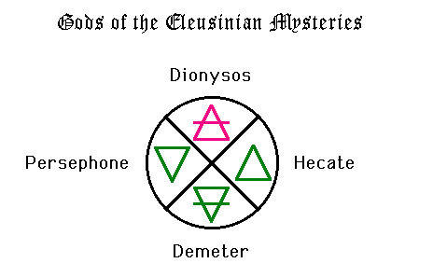
Deification in the Mystery Cults
The mysteries are the nearest to a genuinely personal religion in antiquity. But we know little about the mysteries, because initiates were sworn to secrecy about everything beyond the preliminaries. But we have ample testimonies to the eﬀects of the rites. The most celebrated of these is that of Plato, who in the Phaedrus compares the
philosopher’s joy at the vision
of true Being with the elation
and sense of liberation that
comes to the initiate at the
climax of the mystery
[at Eleusis], the moment
of ﬁnal revelation.

Slide 19
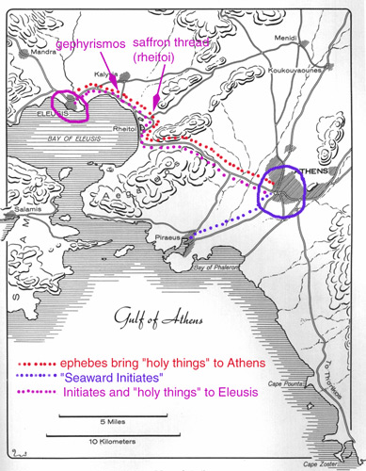
The Eleusinian Mysteries were, by the 5th century BC,
open to any Greek speaker, man, woman, or slave,
citizen or not of Attica. Warfare was (ideally, but not
always) suspended for the period of the initiations,
which took 7 days.
Two days before the Mysteries began the "holy things"
were brought in baskets to Athens by the ephebes,
young Athenians in military training.
On the first day, the initiates gathered in Athens and
met their mystagogus (a person already initiated
who helped them through the process).
On the second day, the initiates took little piglets down
to the sea, bathed with them, and purified themselves
with blood of the sacrificed piglet.
The initiates spent the next two days indoors at Athens--
doing what, we are not too sure, but perhaps sacrificing
privately to Demeter and Persephone, and performing what we might call meditation.
Then on the fifth day, they made the long march with the "sacred things" back to Eleusis, where the sacred things were revealed in the Telesterion on the 20th. On the last day, two odd-shaped vessels filled with water were tipped out to the east and west by each initiate, who uttered a mystical phrase...which has not been recorded.

Slide 20
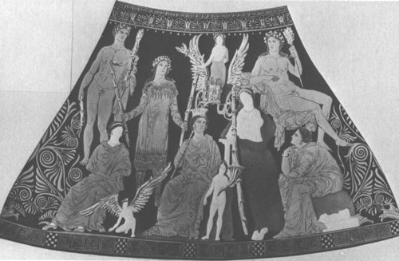
After the long march to Eleusis,
the initiates arrived in the evening of
the fifth day in the sacred precinct of
the two goddesses, Demeter and
Persephone. The next day, a huge
offering of grain is made to Demeter
and Persephone, but the initiates
themselves fast until evening, when
they drink a pennyroyal mixture
called kykeion. This red-figure vase
shows the major female figures in the myth
(Persephone, Demeter, Hecate, and Iambe, from left to right), with Hercules (the most famous mythological initiate) at upper left and Iacchos/Dionysus at upper right. In the center in Triptolemus, the mortal child of the king of Eleusis, to whom Demeter gave the gift of agriculture, and in the left center, a priest of the Eumolpidae, an aristocratic family of Eleusis which provided the "hierophant," the "shower of the sacred things." He carries two torches...the manipulation of light inside the dark Telesterion was apparently part of the mystical experience.

Slide 21
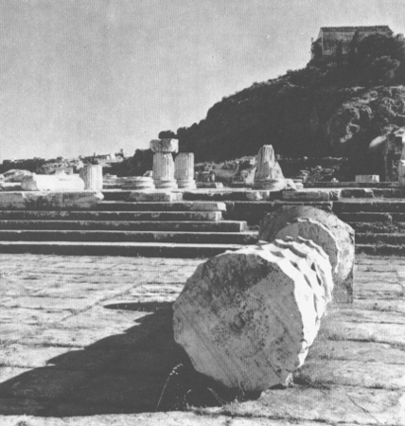
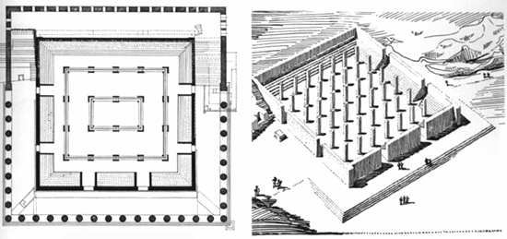
The Telesterion itself was unlike any other Greek temple. Its seats were cut into the rock itself, and it was designed to hold the large number of initiates in the darkness until they experience the "things said, things done, and things revealed." Inside the Telesterion was the Anaktoron, a chamber that only the Hierophant was allowed to enter, and from which, at some point, he spectacularly emerged. Below is an artist’s reconstruction of the
Telesterion in the 5th century BC.

Slide 22
Deification in the Mystery Cults
Eleusis retained its power to move and inspire right up to its destruction in 395AD.
The Neoplatonist Proclus gives us the last testimony to the eﬀects of the rites, which he had received from the daughter of one of the last hierophants:
They cause sympathy of the souls with the ritual in a way that is unintelligible to us, and divine, so that some of the initiands are stricken with panic, being ﬁlled with divine awe; others assimilate themselves to the holy symbols, leave their own identity, become at home with the gods and experience divine possession.
The experience of initiation is everything. There is no salvation from sin, no theology of death and rebirth, no higher spirituality. The emphasis is always on ‘blessedness’, an intense feeling which carries with it the hope of a better life in the next world.

Slide 23
Deification in the Mystery Cults
The Dionysiac/Bacchic mystery cults spoke more clearly of an afterlife. For example, from southern Italy: the dead person is the child of earth and heaven but really of the heavenly race alone. ‘Happy and blessed one, a god you will be instead of a mortal.’ The human race was created from the ashes of the Titans, who had been destroyed by Zeus because they had devoured Dionysus, the Divine Child. As a result of its creation from matter that was at once both Dionysian and Titanic, human nature had a dual character. The Titanic element was the body or prison of the soul. The Dionysian element was the soul, the divine spark or δαίµων trapped in the body until it could be released through a life of asceticism and puriﬁcation; or through several lives, for the soul to realize its true divinity and mount upwards never to return.

Slide 24
Deification in the Mystery Cults
Empedocles (5thc BC) of Acragas in Sicily:
Friends who inhabit the mighty town by tawny Acragas which crowns the citadel, caring for good deeds, greetings; I, an immortal God, no longer mortal, wander among you, honored by all, adorned with holy diadems and blooming garlands. To whatever illustrious towns I go, I am praised by men and women, and accompanied by thousands, who thirst for deliverance, some ask for prophecies, and some entreat, for remedies against all kinds of disease.
In Empedocles’ view his soul had arrived at the last of its embodied lives. After death it would return no more to the ‘roofed-over cave’ of this world as ‘an exile from the gods and a wanderer’ but enjoy immortality for ever in the abodes of the blessed.

Slide 25
Deification in the Mystery Cults
Plato gave the idea of the soul as the essential self that can exist independently of the body its full development, with profound consequences not only for the Platonic philosophical tradition but also for Judaism and Christianity. Two of Plato’s more important discussions of the soul mention the mysteries as paradigms of the soul’s primeval vision of blessedness when it was still free of the prison-house of the body (Phaedo 81a; Phaedrus 250b). All human souls have experienced that vision at one time or else they would have descended not into human bodies but into some lower form of animal life. The philosopher’s soul alone, however, is able to recover that vision, to reverse the eﬀects of the fall and ﬂee to a realm which is divine and immortal, never to return.

Slide 26
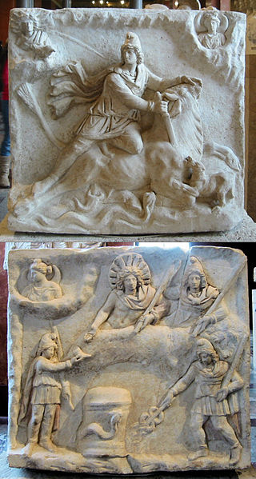
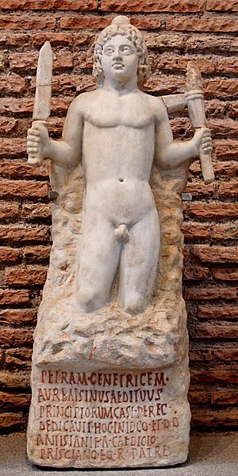
Deification in the Mystery Cults
Cult of Mithras: Iranian, syncretistic origin.
With its cult of deus invictus it appealed especially to soldiers. In fact it was entirely masculine. No women were admitted, nor were there itinerant priests or thiasoi or temples, as with the other mysteries.

Slide 27
Deification in the Mystery Cults
Cult of Mithras
Groups of men met in windowless chapels ––‘caves’ they were called, although the imagery of Mithraic myth is astral rather than chthonic––where their worship seems to have aimed at a transcending of the world. There were seven grades of initiation, corresponding to an ascent through the seven planetary spheres. The goal of the worshipper was to become one with the cosmos. ‘I alone’, says a fragment of a Mithraic liturgy, ‘may ascend into heaven as an enquirer and behold the universe’.

Slide 28
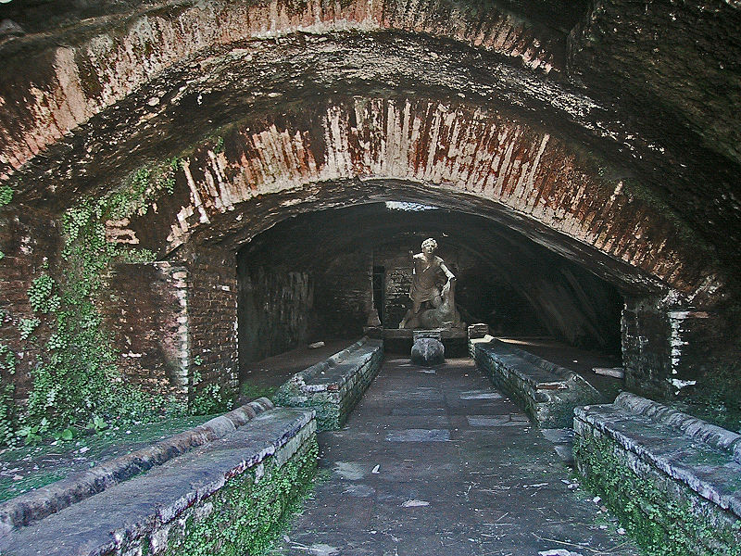
A mithraeum found in the ruins of Ostia Antica, Italy

Slide 29
Deification in the Mystery Cults
Cult of Antinous
In 130AD, during an imperial visit to Egypt the young eromenos of the Emperor Hadrian was drowned in the Nile, either by accident or, perhaps, as was popularly believed, as a voluntary sacriﬁce to restore the emperor to health and avert evil to the empire. Hadrian was inconsolable after the death of his beloved. He lingered in Egypt while the body of Antinous was prepared for burial. In October 130 he founded the city of Antinoopolis in his honor and instituted annual games. He immediately began promoting the cult of Antinous-Osiris in Egypt and throughout the empire.

Slide 30
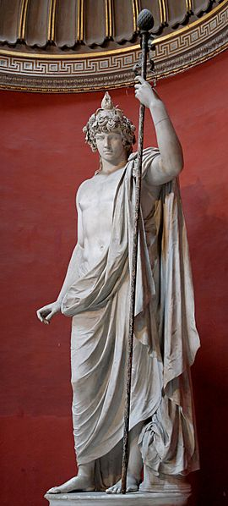
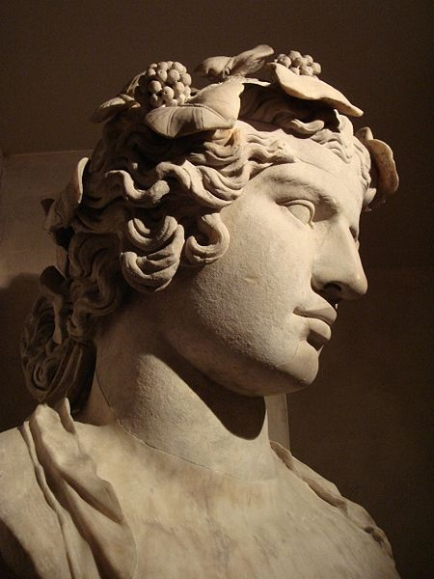
Deification in the Mystery Cults
Cult of Antinous
Temples were constructed, coins, medallions, and domestic busts were produced in large numbers. Mysteries were organized at Antinoopolis, the chief center of the cult, and Bithynion, Antinous’ birthplace.
Bust of Antinous found at Hadrian’s Villa
Antinous as Bacchus

Slide 31
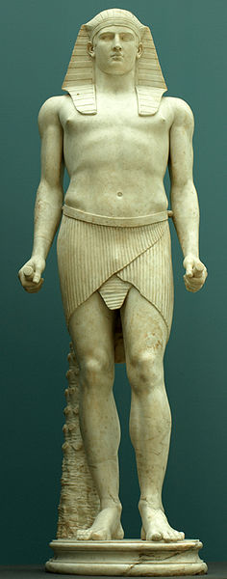
Deification in the Mystery Cults
Cult of Antinous
Because he had died for love, Antinous became the god of triumph over death. In Egypt he was enthroned in the temples with the other gods. Elsewhere he was assimilated to Hermes or Dionysus. The high-minded condemned the cult, but popular devotion endowed the worship of Antinous with a real vitality: having conquered death himself he oﬀered to others the prospect of eternal life.
Antinous as Osiris

Slide 32
Christian Response to the Mysteries
Disgust and contempt, the general attitude among Christians.
Clement of Alexandria, in his Protrepticus: "Another new deity was added to the number with great religious pomp in Egypt, and was near being so in Greece by the king of the Romans [Hadrian], who deified Antinous, whom he loved as Zeus loved Ganymede, and whose beauty was of a very rare order: for lust is not easily restrained, destitute as it is of fear; and men now observe the sacred nights of Antinous, the shameful character of which the lover who spent them with him knew well. Why reckon him among the gods, who is honored on account of uncleanness? And why should you enlarge on his beauty? Beauty blighted by vice is loathsome….”

Slide 33
Christian Response to the Mysteries
But Clement pictured the true mysteries of the Logos in the very imagery of their pagan counterpart:
O truly sacred mysteries! O pure light! In the blaze of the torches I have a vision of heaven and of God. I become holy by initiation. The Lord reveals the mysteries; he marks the worshipper with his seal, gives light to guide his way, and commends him, when he has believed, to the Father’s care, where he is guarded for ages to come. These are the revels of my mysteries! If you will, be initiated too, and you shall dance with angels around the unbegotten and imperishable and only true God, the Logos of God joining with us in our hymn of praise.
Clement wood his readers and listeners by capitalizing on the longing for illumination and assurance that the mysteries sought to satisfy! He trumped the pagan version with his own images of joy and self-forgetful union with God.

Slide 34
Criticism of Deification within NT?
Acts 14:11-18 When the crowds saw what Paul had done, they shouted in the Lycaonian language, “The gods have come down to us in human form!” Barnabas they called Zeus, and Paul they called Hermes, because he was the chief speaker. The priest of Zeus, whose temple was just outside the city, brought oxen and garlands to the gates; he and the crowds wanted to offer sacrifice. When the apostles Barnabas and Paul heard of it, they tore their clothes and rushed out into the crowd, shouting, “Friends, why are you doing this? We are mortals just like you, and we bring you good news, that you should turn from these worthless things to the living God, who made the heaven and the earth and the sea and all that is in them. In past generations he allowed all the nations to follow their own ways; yet he has not left himself without a witness in doing good—giving you rains from heaven and fruitful seasons, and filling you with food and your hearts with joy.” Even with these words, they scarcely restrained the crowds from offering sacrifice to them.

Slide 35
Criticism of Deification within NT?
Acts 19:23-27 About that time no little disturbance broke out concerning the Way. A man named Demetrius, a silversmith who made silver shrines of Artemis, brought no little business to the artisans. These he gathered together, with the workers of the same trade, and said, “Men, you know that we get our wealth from this business. You also see and hear that not only in Ephesus but in almost the whole of Asia this Paul has persuaded and drawn away a considerable number of people by saying that gods made with hands are not gods. And there is danger not only that this trade of ours may come into disrepute but also that the temple of the great goddess Artemis will be scorned, and she will be deprived of her majesty that brought all Asia and the world to worship her.”

Slide 36
Criticism of Deification within NT?
Acts 28:1–6 After we had reached safety, we then learned that the island was called Malta. The natives showed us unusual kindness… they kindled a fire and welcomed all of us around it. Paul had gathered a bundle of brushwood and was putting it on the fire, when a viper… fastened itself on his hand. When the natives saw the creature hanging from his hand, they said to one another, “This man must be a murderer; though he has escaped from the sea, justice has not allowed him to live.” He, however, shook off the creature into the fire and suffered no harm. They were expecting him to swell up or drop dead, but after they had waited a long time and saw that nothing unusual had happened to him, they changed their minds and began to say that he was a god.

Slide 37
Criticism of Deification within NT?
1 Cor 8:4-6 Hence, as to the eating of food offered to idols, we know that “no idol in the world really exists,” and that “there is no God but one.” Indeed, even though there may be so-called gods in heaven or on earth—as in fact there are many gods and many lords— yet for us there is one God, the Father, from whom are all things and for whom we exist, and one Lord, Jesus Christ, through whom are all things and through whom we exist.
Colossians 2:20-23 If with Christ you died to the elemental spirits of the universe, why do you live as if you still belonged to the world? Why do you submit to regulations, “Do not handle, Do not taste, Do not touch”? All these regulations refer to things that perish with use; they are simply human commands and teachings. These have indeed an appearance of wisdom in promoting self-imposed piety, humility, and severe treatment of the body, but they are of no value in checking self-indulgence.

Slide 38
Criticism of Deification within NT?
Galatians 4:3 So with us; while we were minors, we were enslaved to the elemental spirits (στοιχεῖα) of the world.
Galatians 4:8-10 Formerly, when you did not know God, you were enslaved to beings that by nature are not gods. Now, however, that you have come to know God, or rather to be known by God, how can you turn back again to the weak and beggarly elemental spirits (στοιχεῖα)? How can you want to be enslaved to them again? You are observing special days, and months, and seasons, and years.
Colossians 2:8 See to it that no one takes you captive through philosophy and empty deceit, according to human tradition, according to the elemental spirits (στοιχεῖα) of the universe, and not according to Christ.

Slide 39
Deification in the Philosophers
The mystery cults certainly had a great impact on the ordinary people of the ancient world, while the philosophers spoke primarily to the better educated segments of the population. But it was the philosophers that had the greater influence on Christian theology.
The influence of Greek philosophy, especially Plato and the neo-Platonists, on patristic theology is well known and universally acknowledged, and not always in a positive way. We will see some of this influence as we move into the patristic concepts of deification.

Slide 40
Deification in the Philosophers
Clasical Greek thought displays a union of mysticism and rationality, and of knowledge and praxis. The human capacity of reason provides the basis and potential for divinity in human beings. Nous (mind, reason) is the highest and most godlike part of us. Since all human beings share a capacity for reason, and participate in divine reason through contemplation, deification is possible for all people, though only achieved by true philosophers like Socrates.
Greek philosophy is less about assertions and speculations than about a way of life. A spiritual way of life: a pursuit of the best, most perfect life, comparable to that of the gods.

Slide 41
Deification in the Philosophers
In Plato’s Phaedo, Socrates asserts that the job of philosophy is to care for the soul for all time. Its only hope of achieving the “best and highest good” of “becoming as good and wise as it possibly can,” is through “education and training” for the benefit of its “journey to the other world.” The belief that the soul lives on after death requires that it be eternal and preexistent.
That is why we should make all speed to take flight from this world to the other, and that means becoming like the divine so far as we can, and that again is to become righteous with the help of wisdom… Nothing is more like the divine than any one of us who becomes as righteous as possible. (Theaetetus, 176b)

