Slide 1
Theosis: The Transformation of Human Nature through Participation in the Divine Nature
A Tuesday-night series of learning at Holy Trinity Church
Winter-Spring 2013

Slide 2
The Cappadocian Synthesis
Three great Cappadocian Fathers: Basil of Caesarea, Gregory of Nyssa, Gregory of Nazianzus.
They combined Athanasius’ teaching about the deification of the flesh which the Logos assumed with the Platonic tradition of the soul’s ascent to God, or attainment of likeness to God. They were also deeply indebted to Athanasius’ precursors in the Alexandrian tradition, Clement and Origen.
They were without a doubt the most classically oriented of all the Greek Fathers, deeply comfortable and trained in classical Greek philosophy and philology.

Slide 3
Basil of Caesarea (c. 329-79)
Deification is a gradual process, in which human beings can be referred to as ‘gods’ only in the final state. Our telos is the blessedness of life in heaven.
Unlike Athanasius, Basil did not speak of deification of the flesh, nor did he connect deification with Baptism. For him, the ‘gods’ are those who achieve perfection through the practice of the virtues, which for him meant primarily imitation of Christ: ούτος όρος χριστιανισμού, μίμησις Χριστού εν τω μέτρω της ενανθρωπήσεως.
The Holy Spirit is the sanctifying and deifying agent of creation (το της κτίσεως αγιαστικόν και θεοποιόν) who fills it with the divine energies (Adv. Eun. 5).

Slide 4
“Through the Spirit hearts are lifted up, the weak are led by the hand, and they who are advancing are brought to perfection. Shining upon those that are cleansed from every stain, he makes them spiritual by communion with himself. Just as when a sunbeam falls on bright and transparent bodies, they themselves become brilliant too, and shed forth a fresh brightness from themselves, so spirit-bearing souls (αι πνευματοφόροι ψυχαί), illuminated by the Spirit, themselves become spiritual, and send forth their grace to others. Hence comes foreknowledge of the future, understanding of mysteries, apprehension of what is hidden, distribution of good gifts, the heavenly citizenship, a place in the chorus of angels, joy without end, abiding in God, being made like God, and the highest goal of all, becoming a god (το ακρότατον των ορεκτών, θεόν γενέσθαι). (De Sp. S. 9.23)

Slide 5
Gregory of Nazianzus (c. 330-90)
He was the first to coin the noun θέωσις.
His favorite verb for deification is θεόω.
One of his favorite terms was ‘mingling’: “What greater destiny can befall our humility than that humanity should be intermingled with God, and by this intermingling should become divine?” (Or. 30) This new deified humanity is granted through baptism.
In Christ, both the human and the divine form a single entity: “For both [natures] are one by mingling, God inhominated and man deified (τα γαρ αμφότερα εν τη συγκράσει, θεού μεν ενανθρωπήσαντος, ανθρώπου δε θεωθέντος), or however one should express it” (Ep. 101).

Slide 6
Gregory of Nazianzus (c. 330-90)
Deification was keystone of Gregory’s vision of salvation. This goes beyond restoration to Adamic state before the Fall, but rather to attain the goal for which Adam was created, namely to be deified.
Strong emphasis on sacraments: Christ and the Spirit deify human beings through Baptism. The Eucharist contributes to the process of deification.
Ethical life essential to deification! Gregory greatly valued the ascetic ideal, but not only for monks: freedom from the material world.
Imitation of Christ leads to transformation (metamorphosis) by ‘mingling’ with the divine light. (Icon of Transfiguration?)

Slide 7
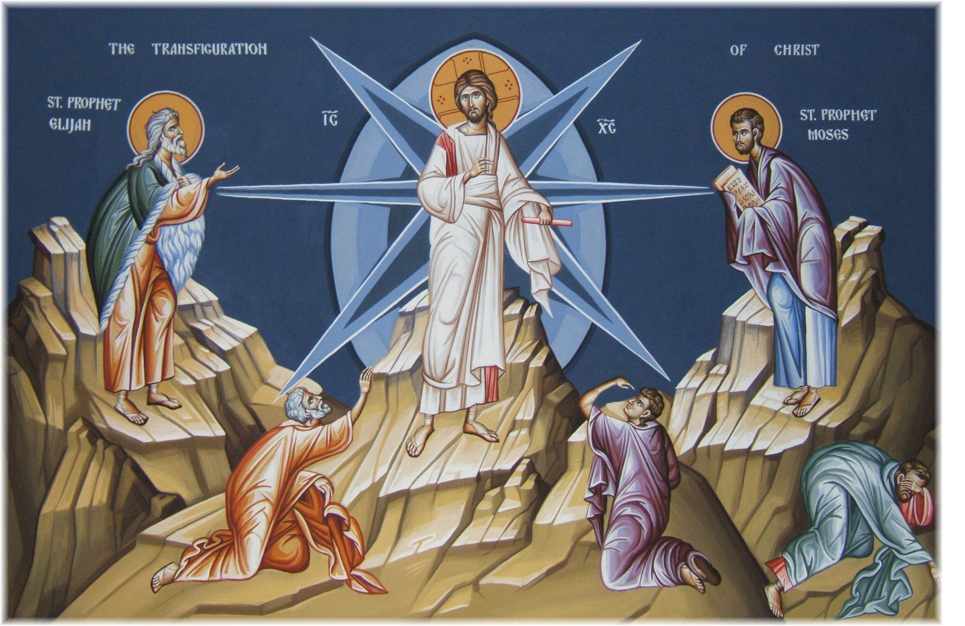

Slide 8
Gregory Speaks of Deification
“While His inferior nature, the humanity, became God, because it was united to God, and became One Person because the higher nature prevailed in order that I too might be made God so far as He is made Man (Or. 29).
“He assumes the poverty of my flesh, that I may assume the richness of His Godhead” (Or. 40).
“I must be buried with Christ, arise with Christ, be joint heir with Christ, become the son of God, yea, God himself (θεόν αυτόν)” (Or. 7).
“You are an image of God, but you also control this image… Honor the nature you have in common (συμφυΐαν); respect your archetype (αρχέτυπον); ally yourself with God” (Or. 17).

Slide 9
Gregory Speaks of Deification
“I will baptize you and make you a disciple in the Name of the Father and of the Son and of the Holy Spirit; and these three have one common name, the Godhead (θεότης). And you shall know, both by appearances and by words that you reject all ungodliness, and are united to all the Godhead (ούτως όλη θεότητι συντασσόμενος)” (Or. 40).
“This is the meaning of our great mystery, this our faith and rebirth in the Father, Son and Holy Spirit, and in our common name, our rejection of godlessness and our confession of Godhead (θεότητος). To dishonor or separate any one of the three is to dishonor our confession of faith, that is, our rebirth, our Godhead (θεότητα), our deification (θέωσιν), our hope” (Or. 23).

Slide 10
Gregory of Nyssa (330-94)
Younger brother of Basil and friend of Gregory Nazianzen.
Considered by many to be a ‘speculative theologian’.
He avoided deification language, perhaps out of fear of weakening the utter transcendence and unknowability of God. (The apophatic approach was very important in his mystical writings.)
Instead, he used the language of participation to express the ever-deepening relationship with God through union with the divine energies, while the divine essence remained beyond human comprehension (Russell, p. 232).

Slide 11
Gregory of Nyssa (330-94)
“And if a man is free from evil he becomes, so to speak, a god by his very way of life, since he verifies in himself that which reason finds in the divine nature. Do you realize to what height the Lord raises his hearers through the words of the prayer by which he somehow transforms human nature into what is divine? For he lays down that those who approach God should themselves become gods.” (Or. Dom. 5)
To approach God as Benefactor, one should become a benefactor oneself; to approach him as Good, one should become good, to approach him as Righteous, as Magnanimous, etc… We participate in the divine attributes (ιδιώματα).

Slide 12
Gregory of Nyssa (330-94)
Beatitude is the attribute of God par excellence: θεού γαρ ως αληθώς ίδιον η μακαριότης εστιν. Through each beatitude (Matthew 5:3-11) the Lord deifies as it were (θεοποιείν τρόπον τινά) the person who hears him if that person understands the word rightly. The merciful, for example, become blessed because they receive mercy from God. “If therefore the term ‘merciful’ is suited to God, what else does the Word invite you to become but a god, since you ought to model yourself on the property of the Godhead?” (De Beat. 5)
We transcend our nature not by ascetical effort but as sacramental gift (εκβαίνει την εαυτού φύσιν ο άνθρωπος... θεός εξ ανθρώπου γινόμενος) (De Beat. 7)

Slide 13
Gregory of Nyssa (330-94)
In his great spiritual writings (Homilies on the Song of Songs, Life of Moses), Gregory describes the soul’s ascent to the immediate presence of God using the images of light, cloud and darkness – classic expressions of the apophatic approach.
Way of light = purificatory stage. Turning away from deception to the reality that is God, the soul is bathed in divine light and acquires gifts of apatheia and parrhesia.
Way of cloud (Platonic theoria) = contemplation of reality.
Way of darkness = the utterly transcendent and incomprehensible God nevertheless is in communion with the soul. Perpetual advance of the soul as it is drawn ever more deeply into the experience of God’s presence.

Slide 14
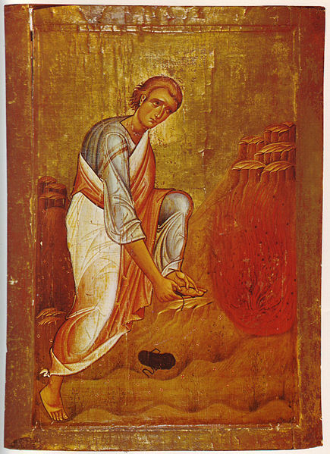
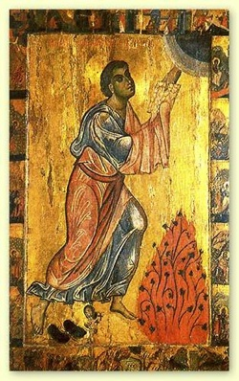
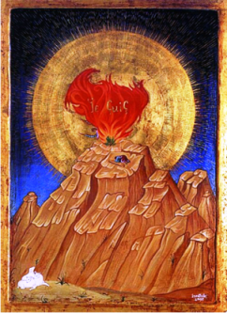

Slide 15
Climax of Alexandrian Theology: Cyril
Two competing schools of biblical interpretation in the ancient church: the Antiochene and Alexandrian schools. For the most part co-existed, but tensions arose over theological conclusions.
Nestorius ascended bishop’s throne in Constantinople in 428 and created huge theological crisis through his teaching about the person of Christ.
Cyril, patriarch of Alexandria at the time, responded to Nestorius and led to Ecumenical Council of Ephesus in 431.

Slide 16
Cyril of Alexandria (c. 378-444)
Just as the deification teachings of Athanasius and the Cappadocians were heavily determined by the Arian crisis and the desire to assert as fully as possible the full reality of the incarnation of Christ, the deification teachings of Cyril were the result of the conflict with Nestorianism. The full integrity of the person of Christ, in opposition to Nestorius’ separation of Christ’s natures had direct and logical consequences as to the destiny of humans redeemed by Christ. The Antiochene approach could not possibly come to the same conclusions and hence could not conceive of deification to any serious degree. (cf. Kostas Sarantidis, ‘Nature’ and ‘Person’: A Study in the Christology of St. Cyril of Alexandria, MDiv dissertation, SVS 1983)

Slide 17
Cyril of Alexandria (c. 378-444)
Theodore of Mopsuestia (c. 350-428) had stressed two separable natures in Christ coexisting in perfect harmony. Our salvation consists in the elevation of our human nature to the same kind of perfect harmony with God which Christ’s humanity enjoys. So the καθώς of John 17:21 refers to Christ’s human nature alone. As if Christ’s ‘I’ is a nature speaking! Cyril’s strting point was the one empirical Christ, both God and man, and the goal of our salvation is the deification of the human nature through our participation in the divine nature – but not our achieving consubstantiality with God’s nature.

Slide 18
Cyril of Alexandria (c. 378-444)
For the Antiochenes our salvation depends on Christ’s identification with us and his human victory over sin and death. But they emphasized so much the reality of Christ’s human sufferings while insisting on the impassibility of God, that they separated the Logos from the human sufferings.
But if the Logos was unaffected by the human temptations, sufferings and death, then what was their benefit? They are nothing more than exemplary actions, but not redemptive – for our redemption lies with a Person, not a nature!
Cyril’s realistic approach did not separate the divine Logos from the human sufferings. His concern was ‘Who suffered’ not ‘What suffered’!

Slide 19
Cyril of Alexandria (c. 378-444)
Nestorius spoke of a moral and relational union, in which the Logos and his humanity are related by an external bond, a simple indwelling of the Logos in “his temple’. Cyril responded that the relationships is neither απλήν nor σχετικήν, but αληθινήν τε και καθ’ υπόστασιν (Adv. Nest. 1). Two natures came together in the person of Jesus Christ, but without confusion or change, ασυγχύτως και ατρέπτως (two key words that became part of the Chalcedonian Creed in 451, together with αδιαιρέτως and αχωρίστως).
A new real state of being came to ‘belong to’ the same subject, the Logos. It is not simply a matter of the Logos possessing or assuming human nature, but coming ‘to be’ something he was not before the incarnation.

Slide 20
Cyril of Alexandria (c. 378-444)
Humanity needed a personal Savior, a Son to make of us sons and daughters. This is what defines personal salvation. But the relation between the person of Christ and all human persons is established through his humanity.
Just as Christ’s death was necessary for its abolition, so his grief, fear and other human passions were necessary if human beings were to be freed from them.
Christ overcame death with his divine power, but he did so as a man. “For if he conquered as God, then it is of no profit to us; but if as man, we are conquerors as well… as we have born the image of the earthly… so shall we bear the image of the heavenly, that is Christ, overcoming the power of sin” (In Joan. 16:33).

Slide 21
Cyril of Alexandria (c. 378-444)
Nestorius had a closed and static understanding of nature: nature as something self-existing and possessing certain identifiable attributes. This explains his difficulties: How could Mary give birth to the divine essence? how could the impassible divine essence suffer and die? and so on. The questions were wrong because the two natures in Christ were more real for him than the single concrete person of Jesus Christ (Sarantidis, p. 51).
In contrast, Cyril penetrated deeply into the mystery of personhood. What is growth in our humanity other than the unfolding of our person? It is the person who en-hypostasizes nature in a unique and individual manner (Sarantidis, p. 41).

Slide 22
Cyril of Alexandria (c. 378-444)
The hypostasis of the Logos became the hypostasis of human nature as well. His human nature did not cease to be fully human, but it came into the closest and most real union with the divine nature. The difference, διαφορά, between the two natures was maintained; not as a source of division, διαίρεσις, but as the source of communion and growth of the human nature to the divine nature. This is the ontological content of deification (theosis). It is not an absorption of the human person by God, but rather the realisation of our potential for a ‘divine’ life through our adoption as sons and daughters of God. The human person remains human, indeed becomes more truly human, for we partake of that deified humanity that was Christ’s own (Sarantidis, p. 52).

