Slide 1
Anastasis
A Keystone to Early Christian Hermeneutics of the Bible – Unity of Scripture, Exegesis, Liturgy & Iconography

Slide 2
The drama that unlocks scripture
At the heart of the Christian story is the Resurrection, the Anastasis of Christ. Early Christian tradition enriched the Gospel descriptions with the so-called “Descent into Hades”. This became one of the keystones to Christian understanding and interpretation of Scriptures, especially the Old Testament.
The Gospel of Nicodemus (or Acts of Pilate) brought together early traditions, though the form in which we have it probably dates from the 4th century. It is non-canonical, but not considered heretical in the church tradition.

Slide 3
The drama that unlocks scripture
Adam and all the patriarchs and prophets are rejoicing at the coming of Christ into the realm of death.
“And while they were all so joyful, Satan the heir of darkness came and said to Hades: O insatiable devourer of all, listen to my words. There is one of the race of the Jews, Jesus by name, who calls himself the Son of God. But he is only a man, and at our instigation the Jews crucified him. And now that he is dead, be prepared that we may secure him here… He did me much harm in the world above… wherever he found my servants he cast them out, and all those whom I had made to be maimed or blind or lame or leprous or the like, he healed with only a word…”

Slide 4
The drama that unlocks scripture
Hades said: Is he so powerful that he does such things with only a word? …”
While Satan and Hades were speaking to one another, a loud voice like thunder sounded: Lift up your gates, O rulers, and be lifted up, O everlasting doors, and the King of glory shall come in. When Hades heard this, he said to Satan: Go out, if you can, and withstand him. So Satan went out. Then Hades said to his demons: Make fast well and strongly the gates of brass and the bars of iron, and hold my locks, and stand upright and watch every point. For if he comes in, woe will seize us.”
Psalm 23:7LXX

Slide 5
The drama that unlocks scripture
When the forefathers heard that, they all began to mock him saying: O all-devouring and insatiable one, open, that the King of glory may come in. The prophet David said: Do you not know, blind one, that when I lived in the world, I prophesied that word: Lift up your gates, O rulers? Isaiah said: I foresaw this by the Holy Spirit and wrote: The dead shall arise, and those who are in the tombs shall be raised up, and those who are under the earth shall rejoice. O death, where is thy sting? O Hades, where is thy victory?
Psalm 23:7
Isaiah 26:19
1 Cor 15:55

Slide 6
The drama that unlocks scripture
Again the voice sounded: Lift up the gates. When Hades heard the voice the second time, he answered as if he did not know it and said: Who is this King of glory? The angels of the Lord said: The Lord strong and mighty, the Lord mighty in battle. And immediately at this answer the gates of brass were broken in pieces and the bars of iron were crushed and all the dead who were bound were loosed from their chains. And the King of glory entered in like a man, and all the dark places of Hades were illumined.
Psalm 23:8
LXX

Slide 7
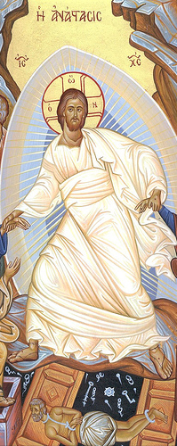
The drama that unlocks scripture
Hades at once cried out: We are defeated, woe to us. But who are you, who have such authority and power? … Then the King of glory seized the chief ruler Satan by the head and handed him over to the angels, saying: Bind with iron fetters his hands and his feet and his neck and his mouth. Then he gave him to Hades and said: Take him and hold him fast until my second coming. (cf. Rev 20:2)

Slide 8
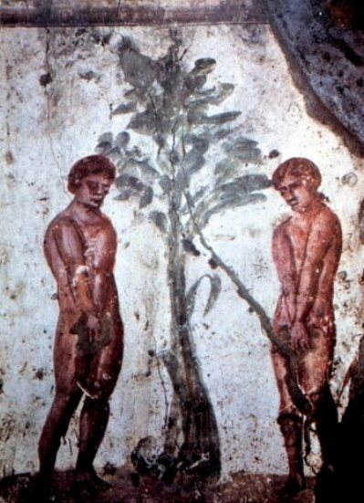
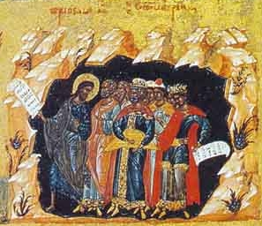
The drama that unlocks scripture
… The King of glory stretched out his right hand and took hold of our forefather Adam and raised him up. Then he turned also to the rest and said: Come with me, all you who have suffered death through the tree which this man touched. For behold, I raise you all up again through the tree of the cross… The Savior blessed Adam with the sign of the cross on his forehead. And he did this also to the patriarchs and prophets and martyrs and ancestors, and he took them and leaped up out of Hades.
Icon of Christ leading the righteous out of Hades

Slide 9
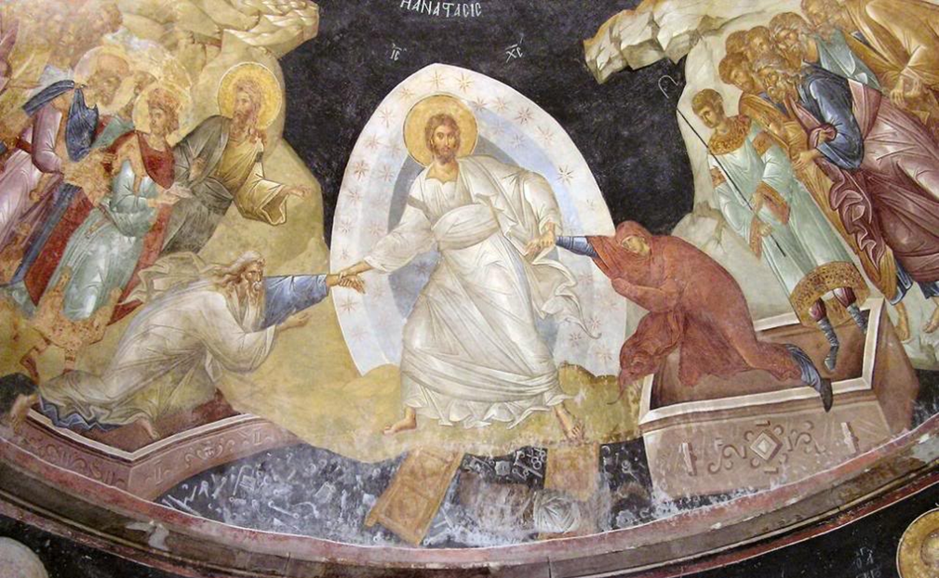

Slide 10
The drama that unlocks scripture
A different application of Psalm 23(24). The Liturgy chose to apply it to Ascension of Christ instead, and this became the dominant interpretation.
But after he had destroyed his enemies through his passion, the Lord, who is mighty in battle and strong, … goes, bearing victory and trophies, with the body that arose from the dead.… Certain powers say, “Who is this that is coming from Edom, with scarlet garments from Bosra, so beautiful?” And those escorting him say to those stationed at the gates of heaven, “Lift up your gates, and the King of glory will come in.” Origen, Commentary on the Gospel of John
Isaiah 63:1

Slide 11
The drama that unlocks scripture
The literal meaning rejected!
Solomon was not the Lord of hosts. But, when our Christ arose from the dead and ascended into heaven, the heavenly princes chosen by God were ordered to open the gates of heaven that the King of glory might enter and sit at the right hand of the Father until he makes his enemies his footstool. Now, when these heavenly princes saw that he was in appearance without beauty, honor or glory, and not recognizing him, they asked, “Who is this King of glory?” And the Holy Spirit, either in his own name or in the Father’s, answered, “The Lord of hosts. He is the King of glory.” But I am sure that everyone will admit that none of the gatekeepers of the temple at Jerusalem ever said of Solomon (though he was ever so glorious a king) or of the ark of testimony, “Who is this King of glory?”
Justin Martyr, Dialogue with Trypho

Slide 12
The drama that unlocks scripture
He comes to the heavenly gates: angels accompany him, and the gates of heaven were closed. For he has not yet ascended into heaven. Now first does he appear to the powers of heaven as flesh ascending. Therefore to these powers it is said by the angels, who are the couriers of the Savior and Lord, “Lift up your gates, you princes; and be lifted up, you everlasting doors; and the King of glory shall come in.” Hippolytus
God spared not his own Son for you… that he might redeem us from our sins. The sun was darkened on the day of our redemption; hell lost its right to us, and we were enrolled for heaven. The eternal gates were lifted up that the King of glory, the Lord of might, might enter in, and humankind, born of the earth, destined for hell, was purchased for heaven. Tertullian

Slide 13
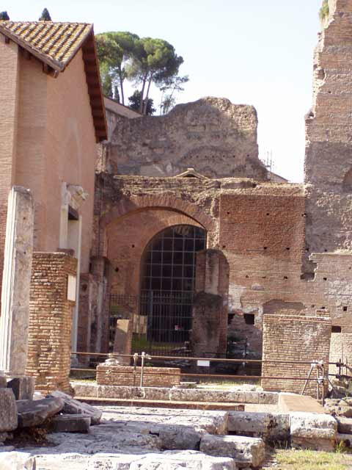
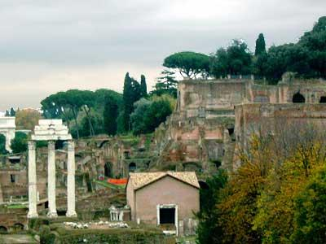
The earliest known representation of the Descent into Hades is a fresco in the Santa Maria Antiqua in Rome from the early 8th century.

Slide 14
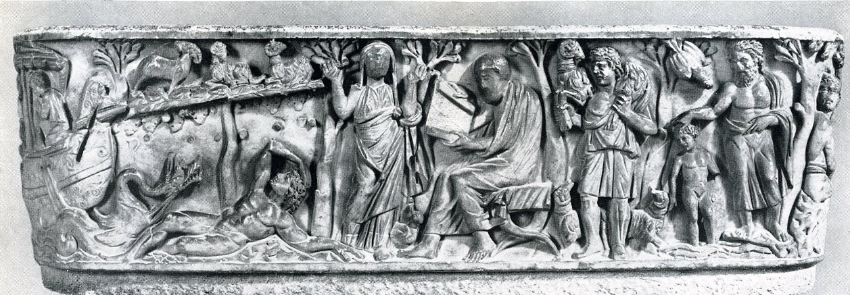
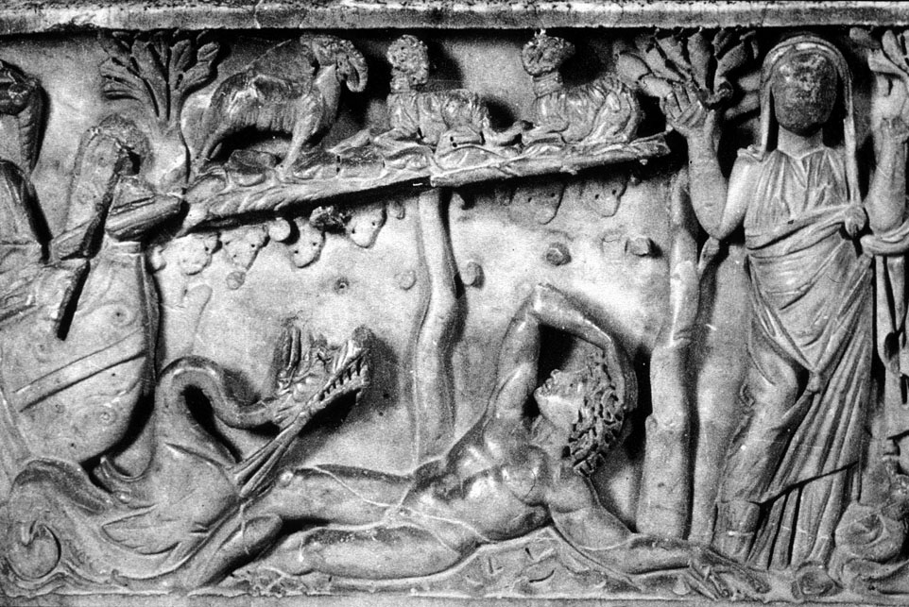
You descended, O Christ, to the depths of the earth. You broke the everlasting bars that held us captive to death, and, like Jonah from the whale, on the third day you arose from the grave. (from the Paschal Canon)
The Jonah sarcophagus at Santa Maria Antiqua

Slide 15
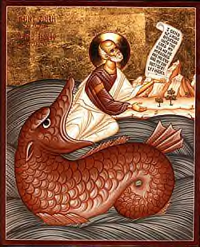
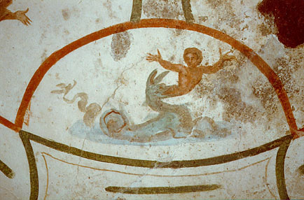
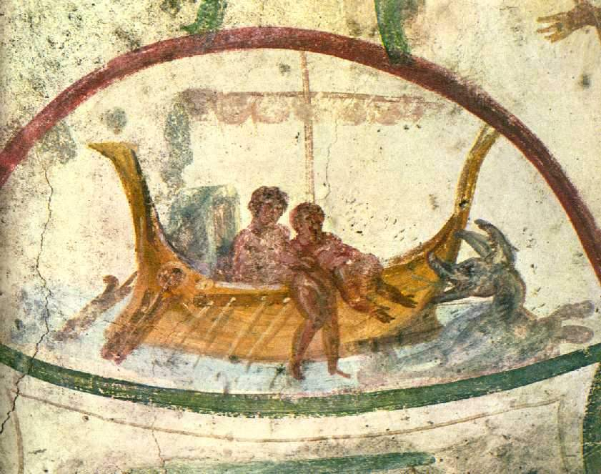
The story of Jonah in the whale became a primary symbol of Christ’s burial and resurrection.
Catacombs of Ss Marcellinus and Peter (early 4th c)

Slide 16
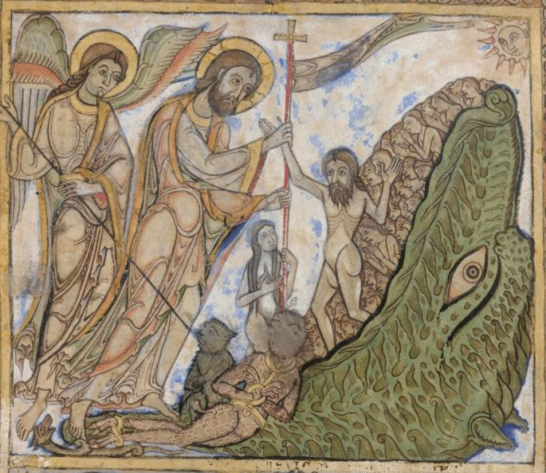
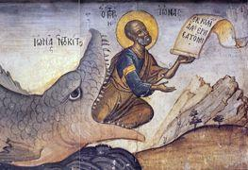
The iconography of Jonah influenced some representations of the raising of Adam and Eve.

Slide 17
Origen, the great exegete
Origen was the most gifted of all theologians of the first 3 or 4 centuries. His approach to Scripture was highlighted by:
Preference for allegory/typology. Christians should proceed from the literal to the higher levels, which he termed “anagogical” (leading), because they led the believer closer to Christ.
He saw the Bible as divine revelation concealed in human form. Only the Holy Spirit can unlock the scriptures and make them intelligible to the church.
He took the literal sense at face value and the spiritual sense as an addition to the literal, not a substitute for it. But he sometimes rejected the literal. For example, he did not accept that the trees in Eden were real objects, or that the devil literally took Jesus to a high mountain.

Slide 18
Origen on the interpretation of scripture
Paul says somewhere: “For we know that our fathers were all under the cloud, and all were baptized into Moses in the cloud and in the sea, and all ate the same supernatural food and all drank the same supernatural drink. For they drank from the supernatural Rock which followed them, and the Rock was Christ.” You see how different Paul’s tradition is from the historical reading: what the Jews think is a crossing of the sea, Paul calls baptism; where they see a cloud, Paul puts the Holy Spirit… Does it not seem right that such a method coming it us from the tradition should serve as a model in all instances? Or shall we, as some would like, abandon what so great and holy an apostle has given us and turn back to “Jewish myths”?
1 Cor 10:1-3
Titus 1:14

Slide 19
Origen on the interpretation of scripture
With this we learn something of general import: if a sign signifies something, then each of the signs in scripture (whether in a historical or law text) is a sign indicative of something to be fulfilled later. Thus “the sign of Jonah” coming forth after three days from “the belly of the whale” was a sign of the resurrection of our Savior rising from the dead after “three days and three nights.” You too now should search out every sign in the old scriptures as a type of something in the new.
Mat 12:39-40

Slide 20
Origen on the interpretation of scripture
We have often pointed out that there is threefold mode of understanding in the holy scripture: a historical, a moral and a mystical.
The holy scripture is made up of seen and unseen things. It consists of a body, namely the visible letter, and of a soul which is the meaning found within it, and of a spirit by which it also has something of the heavenly in it, as the Apostle says: “They serve as a copy and shadow of the heavenly sanctuary.”
Heb 8:5

Slide 21
Origen on the interpretation of scripture
No one has revealed his divinity as John has… No one can grasp its meaning who has not lain on Jesus’ breast and also received Mary from Jesus as one’s own mother. So great must one be who is to become another John in order, like John, to be shown Jesus by Jesus… Jesus says to his mother: “Behold your son”… it is the same as saying: “Behold, this is Jesus to whom you gave birth.” For everyone who has come to perfection “lives no longer,” but “Christ lives” in him. So he says to Mary: Behold your son, Christ.
John 19:26
cf. Gal 2:20

Slide 22
Origen on the interpretation of scripture
There is not just one coming in which my Lord Jesus Christ came down to earth; he also came to Isaiah, and he came to Moses, and he came to the people, and he came to each one of the prophets; and you should have no fear: even if he has already been received, he will come again… “O Jerusalem, Jerusalem… how often would I have gathered your children together!” “How often” indeed. He is not lying.
Mat 23:37

Slide 23
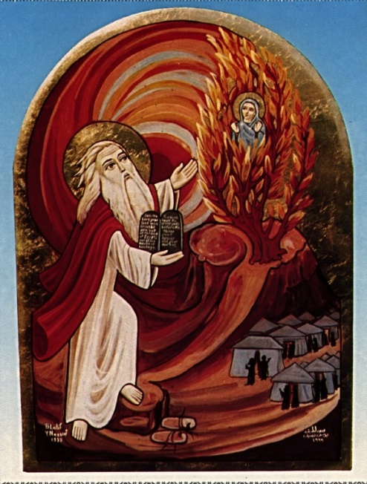
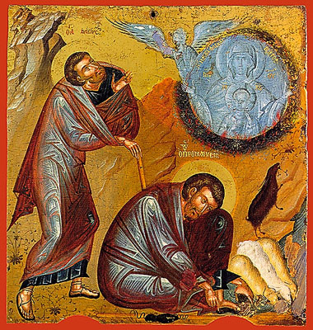
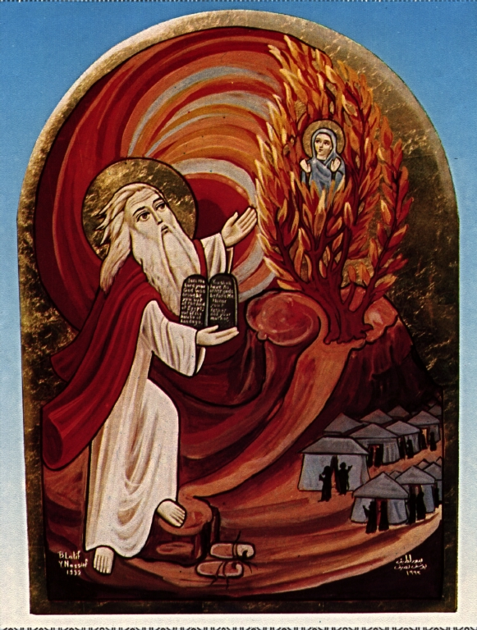
Origen on the interpretation of scripture
Just as “in the last days” the WORD of God, clothed with flesh from Mary, came into the world and there was one thing which was visible in him but quite another which was open to the understanding… so too when the WORD of God is spoken through the prophets and the lawgiver… the letter is seen as it were like flesh while the spiritual meaning, like the divinity, is perceived within.

Slide 24
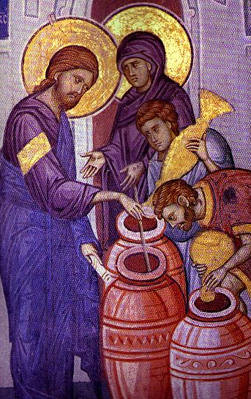
Origen on the interpretation of scripture
For truly, before Jesus, the scripture was water, but after Jesus it has become wine for us. (cf. John 2:6-9)
The law turns into an Old Testament only for those who insist on understanding it according to the flesh; and for them it has necessarily become old and feeble because it is separated from its sources of life. But for us, who understand and interpret it spiritually and according to the gospel, it is always new. Indeed both Testaments are new for us, not because of age but because of newness of understanding.

