Slide 1
Creation and Fall
The Interpretation of Genesis 1-3 in the Early Church
(2nd & 3rd centuries)

Slide 2
THE FACT OF CREATION
This is also part of the church’s teaching: that the world was made and took its beginning at a certain time… But there is no clear statement in the teaching of the church regarding what existed before this world or what will exist after it ... I say that God did not begin to work for the first time when he made this visible world. Just as there will be another world after its destruction, so also I believe that other worlds existed before the present one came into being.
Origen of Alexandria (c. 185-255)

Slide 3
Concerning the creation of the world, what portion of Scripture can give us more information regarding it than the account that Moses has transmitted about its origin? It contains matters of profounder significance than the mere historical narrative appears to indicate… Nevertheless, the language of the narrator reveals that all visible things were created at a certain time. Origen
Celsus harbors a secret desire to discredit the Mosaic account of the Creation. It teaches that the world is not yet 10,000 years old, but, in fact, is very much under that. Origen
I cannot omit here that some erring philosophers say that men and the other animals arose from the earth without any Maker. Lactantius of Rome (c. 250-325)

Slide 4
CREATION BY GOD
I cannot understand how so many distinguished men have been of the opinion that matter was uncreated. That is, it was not formed by God himself, who is the Creator of all things. Rather, they say that its nature and power were the result of chance, thinking that so great a work as the universe could exist without an architect or overseer. Origen
The immediate Creator, and, as it were, the very Maker of the world was the Word, the Son of God. By commanding his own Son, the Word, to create the world, the Father of the Word is the primary Creator. Origen

Slide 5
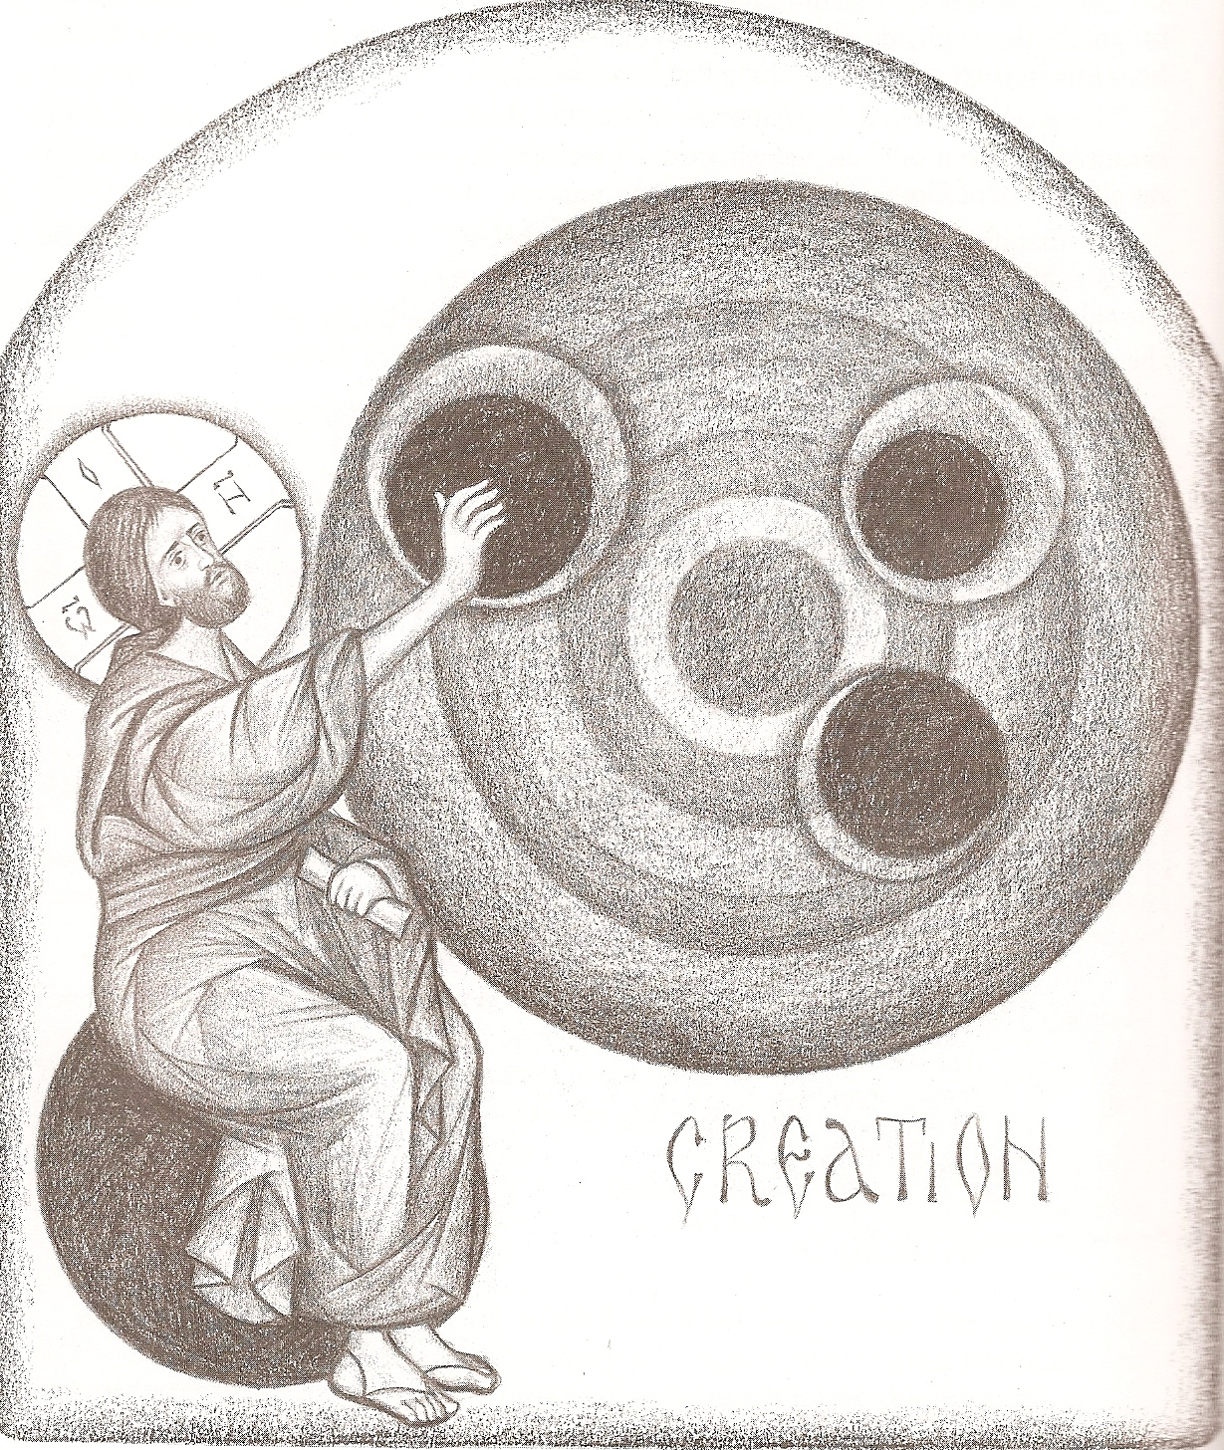
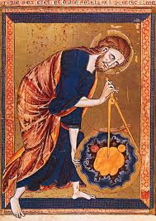
The
Word
of
God Creator

Slide 6
CREATION BY GOD, NOT CHANCE
There are those who give the name of atoms to certain imperishable and most minute bodies that are supposed to be infinite in number, … they allege that these atoms, as they were carried along by chance in the void, all clashed fortuitously against each other in an unregulated whirl. They thereby commingled with one another in a multitude of forms. Entering into combination with each other, they gradually formed this world and all objects in it… This was the opinion of Epicurus and Democritus… How will we bear with these men who assert that all those wise constructions are only the works of common chance?... O you blind ones, do these atoms of yours bring you the winter season and the rains, in order that the earth may yield food for you? Dionysius of Alexandria (died c. 264)

Slide 7
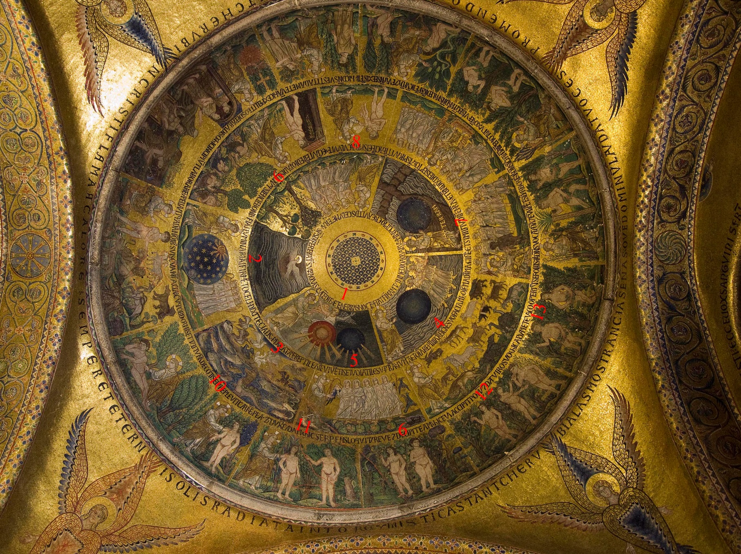
Genesis Creation Dome – St. Mark’s Venice

Slide 8
DAYS OF CREATION
Not even the Law and the Commandments totally convey what is agreeable to reason. For who that has understanding would think that the first, second, and third day - and the evening and the morning - existed without a sun, moon, and stars? Or, who would think that the first day was, as it were, without a sky?... I do not suppose that anyone doubts that these things figuratively indicate certain mysteries - the history having taken place in appearance, and not literally. Origen
On the fourth day, the luminaries were made. This was because God, who possesses for knowledge, knew the follies of the vain philosophers. He knew that they were going to say that the things that grow on the earth are produced from the heavenly bodies. For in this way, the philosophers exclude God...
Theophilus of Antioch (2nd century)

Slide 9
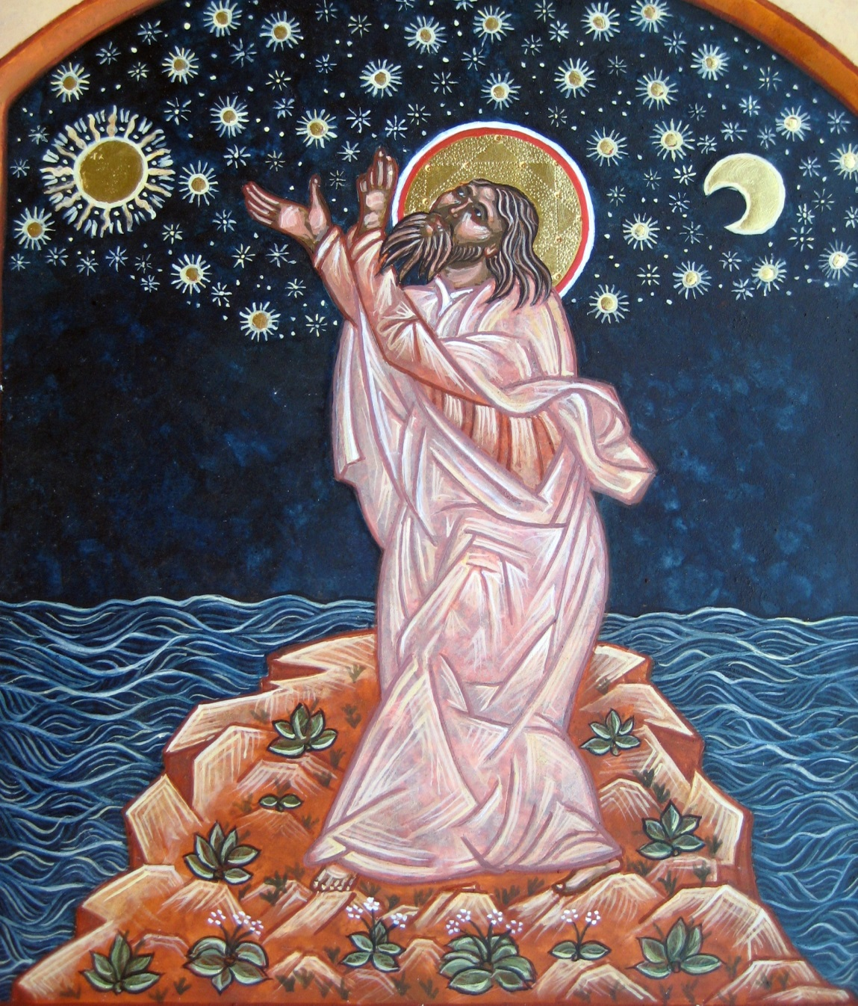
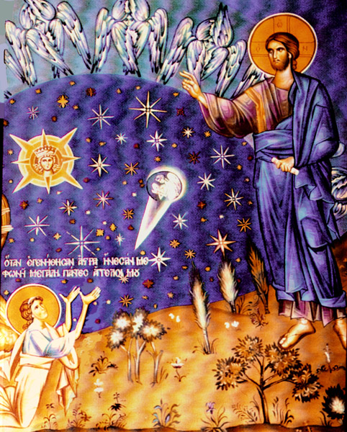
The beginning of Creation

Slide 10
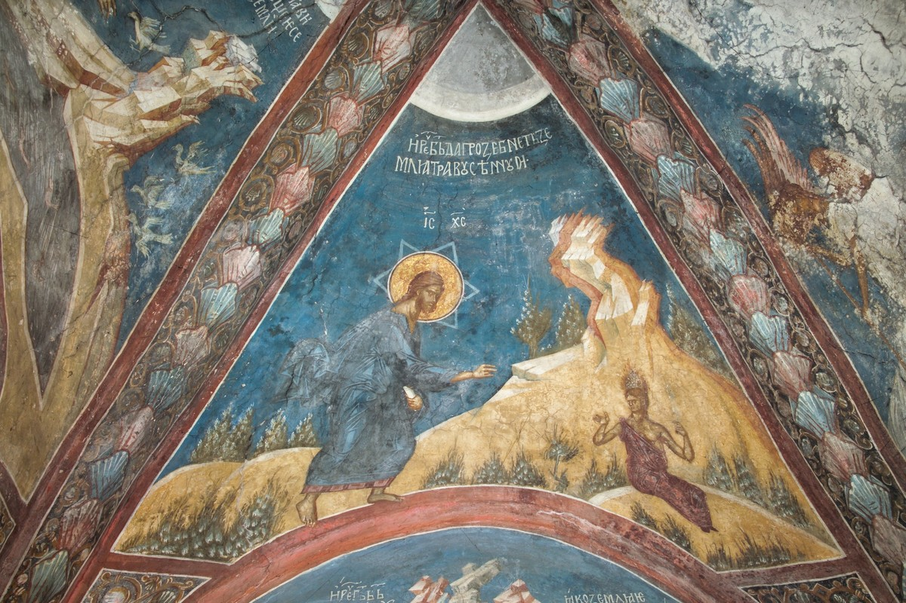
Third day of creation: Creation of grass and herb-yielding seed
Decani Monastery in Serbia (early 14th century)

Slide 11
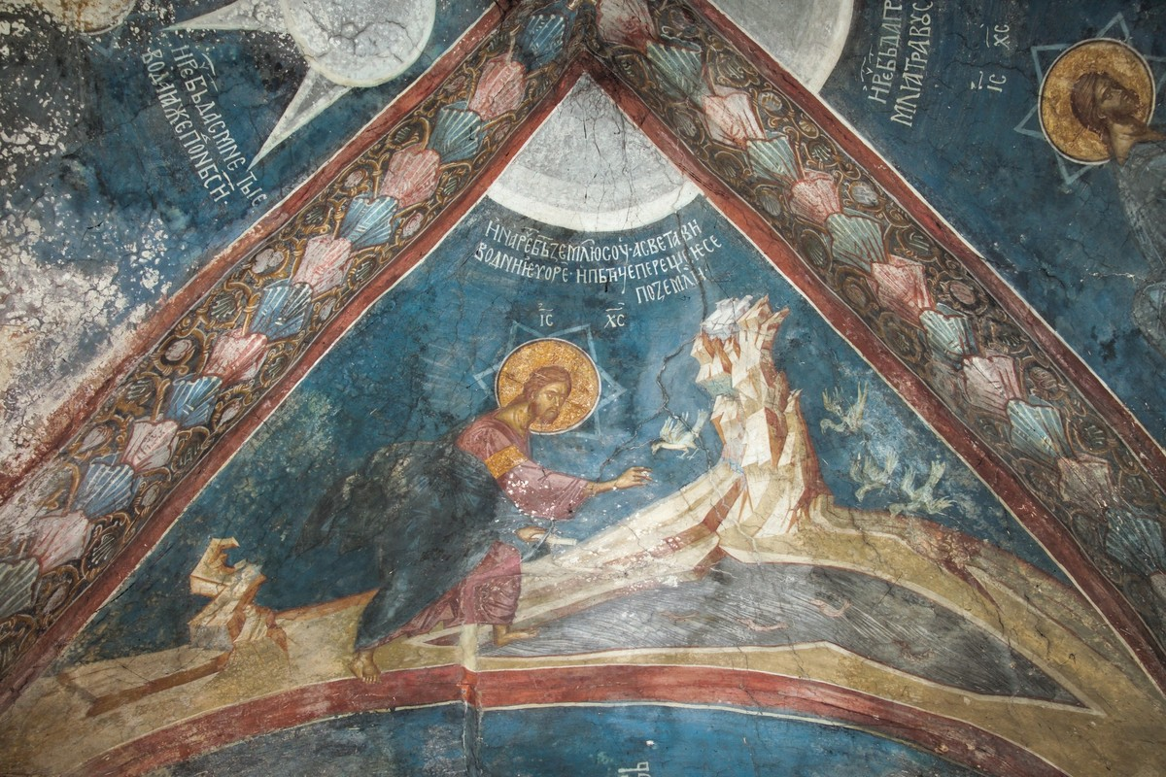
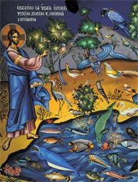
Fifth day of creation: Creation of living creatures in the sea and the birds
Decani Monastery in Serbia (early 14th century)

Slide 12
SABBATH & CONSUMMATION
God’s resting is not, then, as some conceive, that God ceased from doing. If he should ever cease from doing good, then he would cease to be God, which is a sacrilege even to say. Clement of Alexandria (c. 150-215)
It was not said of the seventh day the same as the other days, “And there was evening, and there was morning.” This fact is a distinct indication of the consummation which is to take place in it before the seventh day is finished. Justin Martyr (c. 100-165)
In as many days as this world was made, in so many thousand years will it be concluded. For the day of the Lord is as 1000 years. In six days created things were completed. It is evident, therefore, that they will come to an end at the sixth thousand year. Irenaeus of Lyons (c.130-200)

Slide 13
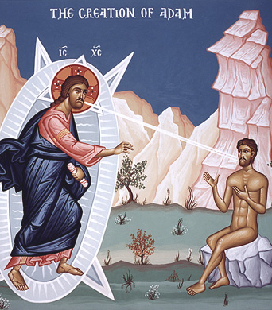
IMAGE AND LIKENESS
"So God created man in the image of God he created him." What else could this image of God be except our Savior who is "the firstborn of all creation" (Col 1:15)?. Origen
In times past it was said that man was made after God's image; but this image was not displayed. For as yet the Word was invisible, after whose image man had been made; and for this reason it was easy for him to lose the likeness. Irenaeus

Slide 14
IMAGE AND LIKENESS
This human, made “in the image of God,” we do not understand as bodily. For no figment of the body contains the image of God, nor is the corporeal human said to be created but formed, as is written in what follows. For it says: “God formed man,” that is shaped him “from the dust of the ground” (Gen 2:7). But the one who was made in the image of God is our internal human, invisible and incorporeal and incorrupt and immortal. Origen

Slide 15
IMAGE AND LIKENESS
The highest good towards which every rational creature is hurrying, also called the end and goal of all things, is to become like God as much as possible. This is indeed what Moses is pointing out above all when he describes the original creation of humankind with the words, “let us make man in our image, after our likeness”… While the human being did indeed receive the dignity of God's image in the first creation the dignity of his likeness is reserved for the consummation. This is so that human beings would work to acquire it by their own efforts to imitate God; for in the beginning only the possibility of perfection is given them by the dignity of the image, while in the end they are to acquire for themselves the perfect likeness by the carrying out of works. Origen

Slide 16
CREATION OF MAN
Because he was still an infant in age, Adam was not yet able to receive the knowledge worthily. For even nowadays, when a child is born, he is not at once able to eat bread. Rather, he is first nourished with milk… It would’ve been the same with Adam. The reason God commanded him not to eat of knowledge was not because God begrudged him, as some suppose. Rather, he wished to test Adam, to see whether he would obey his commandment. At the same time, he man, infant as he was, to remain simple and sincere for a while longer. Theophilus
It was possible for God to have made man perfect from the beginning. However, man could not receive such perfection, being as yet an infant. Irenaeus

Slide 17
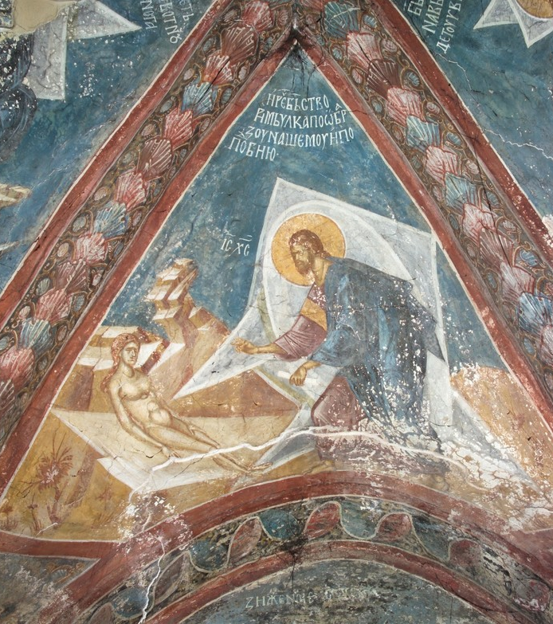
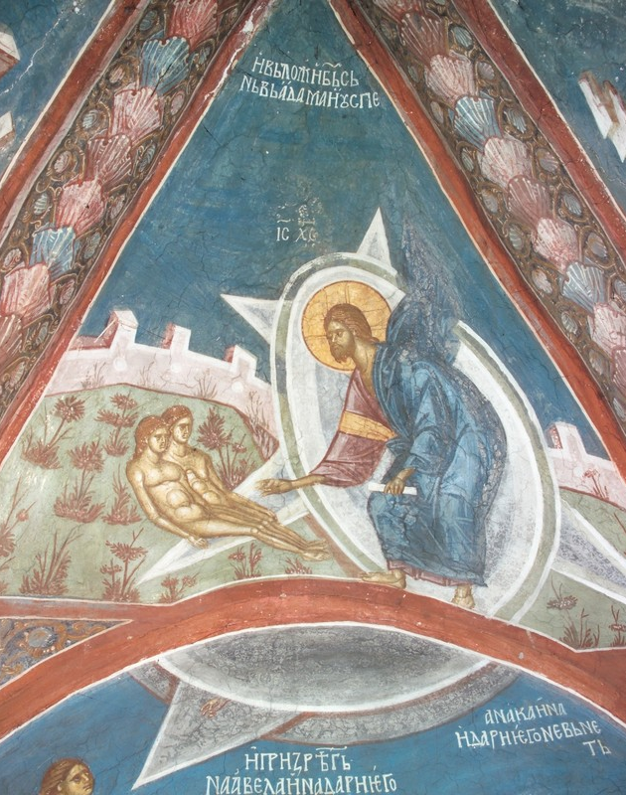
Creation of Adam & Eve (Decani Monastery)

Slide 18
PARADISE
God transferred man out of the earth from which he was made, into Paradise, giving him an opportunity for progress so that by growing and becoming mature, and furthermore having been declared a god, he might also ascend into heaven… possessing immortality. In respect of beauty, this place, Paradise, was made intermediate between earth and heaven. Theophilus
Some persons claim that paradise is in heaven and is not a created thing. But when one sees with one’s own eyes the rivers that flow from it and that can still be seen today, one must conclude that paradise is not heavenly but part of creation. Hippolytus of Rome (c. 170-236)

Slide 19
PARADISE
And God planted a garden eastward in Eden, and there he placed the man whom he had formed. And then afterwards, when man proved disobedient, he was cast out from there into this world. For that reason the elders tell us that those who were translated (i.e. Enoch and Elijah) were transferred to that place. For Paradise has been prepared for righteous man, those who have the Spirit. Likewise, Paul the apostle, when he was translated, heard words and displays that are unspeakable… So it is there that those who have been translated will remain until the consummation of all things, as a prelude to immortality. Irenaeus

Slide 20
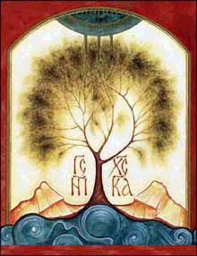
PARADISE & THE TREES
Who is so foolish as to think that God, in the manner of a gardener, planted a Paradise in Eden, towards the east, and placed in it a visible and palpable “tree of life,” of such sort that anyone who tasted its fruit with his bodily teeth would gain life?… that a person could be a partaker of good and evil by eating what was taken from the tree [of knowledge]?... I do not suppose that anyone doubts that these things figuratively indicate certain mysteries. Origen
The tree of knowledge itself was good, and its fruit was good. For there was nothing else in the fruit except knowledge. But knowledge is good when one uses it discreetly. But Adam, being yet an infant in age, was on this account as yet unable to receive knowledge worthily… However, there was not any evil in the tree of knowledge… It was not the tree that had death in it, as some think. Rather, it was the disobedience. Theophilus

Slide 21
FALL & REDEMPTION
Man was made with a free will… on account of his capacity of obeying or disobeying God. For this was the meaning of the gift of free will. Methodius of Olympus (died c. 311)
Adam was perfect as far as his formation. So the cause of his sin lay in his choosing - his choosing what was forbidden. God was not the cause. Clement of Alexandria
In the day that they did eat, in the same day did they die, and became death’s debtors. For it was one day of the creation. It is said, “There was made in the evening, and there was made in the morning, one day.” Now in this same day that they did eat, in that day they also died… From this it is clear that the Lord suffered death, in obedience to his Father, upon that same day on which Adam died while he disobeyed God. Irenaeus

Slide 22
FALL & REDEMPTION
Death was appointed by God for the sinner, so that evil might not remain forever… Adam was formed out of clay. However sin ruined him while he was still soft and moist, for sin flowed and dropped down upon him like water on soft clay. Adam was not yet like a tile, which is hard and incorruptible. Therefore, God moistened him afresh and formed anew the same clay to his honor. He first hardened it and fixed it in the Virgin’s womb, uniting and mixing it with the Word. He then brought it forth into life no longer soft and broken. Methodius
Who that is filled with the Holy Spirit does not see in his heart that on the same day that the Dragon seduced Eve, the angel Gabriel brought the glad tidings to the Virgin Mary… On the same day that the Son made the land and water, he was incarnate in the flesh. Victorinus of Syria (died c. 304)

Slide 23
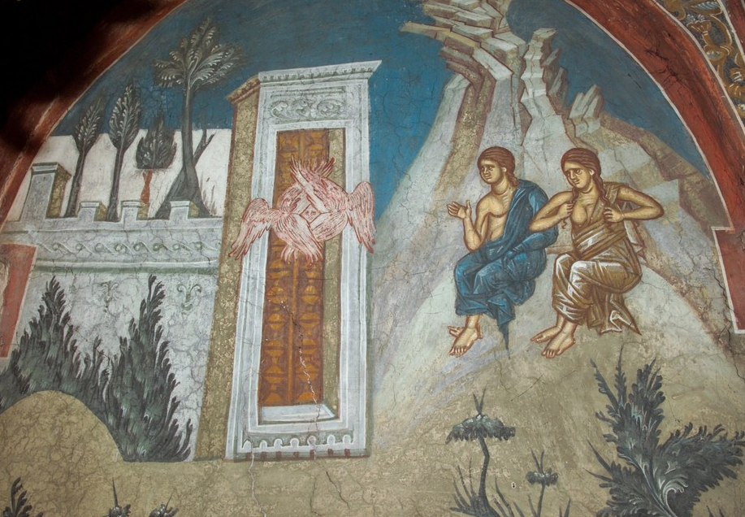
Adam and Eve outside the Gates of Paradise (Decani Monastery)

Slide 24
SATAN & ORIGIN OF EVIL
At the very beginning of the world, the devil was the first one to perish and to destroy… When he saw man made in the image of God, he broke forth into jealous and malevolent envy... How great an evil it was, that caused an angel to fall! Cyprian of Carthage (died 258)
Regarding the devil, his angels, and the opposing forces, the teaching of the church is that these beings do indeed exist. However, the church is not explained with sufficient clarity what they are, or how they exist. Most Christians, however, hold this opinion: that the devil was an angel and that, having become an apostate, he induced as many of the angels as possible to fall away with him. Origen

Slide 25
SATAN & ORIGIN OF EVIL
The apostate angel, having caused the disobedience of mankind by means of the serpent, imagined that he escaped the notice of the Lord. As a result, God assigned him the form and name of the serpent. Irenaeus
The devil was one of those angels who are placed over the spirit of the air… However, becoming envious of the man, he was rendered an apostate from the divine law… The Word of God, however, the Maker of all things, conquered him by means of human nature. So, showing him to be an apostate, Christ has, on the contrary, put him under the power of man. Irenaeus
Man, after his creation, received the commandment from God. And from this, evil quickly arose. For man did not obey the divine command. And this alone is evil: disobedience, which had a beginning. Methodius

Slide 26
SATAN & ORIGIN OF EVIL
God made another being, in whom the disposition of the divine origin did not remain. Therefore, he was infected with his own envy, as with poison. So he passed from good to evil. Through his own will, which had been given to him by God unfettered, he acquired for himself a contrary name. From this, it appears that the source of all evils is envy. For he envied his predecessor [i.e., the Son], who through his steadfastness is acceptable and dear to God the Father. This person, who from good became evil by his own act, is called by the Greeks diabolos [i.e., slanderer]. We called him the Accuser, for he reports to God the faults to which he himself entices us. Lactantius

Slide 27
SATAN & ORIGIN OF EVIL
It might be maintained that if all things were made through the Logos, and evil is a part of all things, then the whole matter of sin - and everything that is wicked - were also made through the Logos. But we must regard this as false… In respect that he is the devil, he is not the work of God. Yet, he who is the devil is a created being. Since there is no other Creator but our God, he is a work of God. It is as if we should say that a murderer is not a work of God. However, we would also say that as to his being a man, God made him. He received his existence as a man from God. However, we do not say that he received his existence as a murderer from God. Origen
God did not make evil. Nor is he at all in any way the Author of evil. But whoever failed to keep the law, after being created by God with the faculty of free will, is called evil. Methodius

Slide 28
WHAT ABOUT “ORIGINAL SIN”?
The early Greek fathers held diverse opinions on the concept of “original” or “inherited” sin. The main question was whether human beings share Adam’s actual guilt or only the consequences of his primal sin.
Adam’s disobedience was only a prototypes; sin results from individual’s exercise of free will (Tatian, Justin).
Sinlessness of infants precludes original sin as reason for infant baptism (Clement of Alexandria and others).
Humanity shared in Adam’s sin, but more a mystical solidarity with Adam (Irenaeus).
The early Latin fathers had a much bleaker picture of human solidarity with Adam, but fell way short of Augustine’s full development of the doctrine of “original sin.”

Slide 29
WHAT ABOUT “ORIGINAL SIN”?
As through a conquered man our race went down to death, so through a conqueror we ascend to life.
Eve by her disobedience brought death upon herself and on all the human race; Mary, by her obedience, brought salvation.
We lost, in Adam, the privilege of being in the image and likeness of God. Irenaeus
Let them say where the newborn child committed fornication, or how that can have fallen under Adam’s curse which has not yet performed any action. They should logically go on to say that not only the birth of the body is evil but also that of the soul on which the body depends. Clement of Alexandria

Slide 30
WHAT ABOUT “ORIGINAL SIN”?
Everyone who enters the world may be said to be affected by a kind of contamination… By the very fact that humanity is placed in its mother’s womb, and that it takes the material of its body from the source of the father’s seed, it may be said to contaminated in respect of both father and mother… Thus everyone is polluted in father and mother. Only Jesus my Lord was born without stain. He was not polluted in respect of his mother, for he entered a body which was not contaminated… For Joseph played no part in his birth other than his devotion and his affection, and it is on account of his faithful devotion that Scripture allows him the name “father.” Origen

Slide 31
ORIGEN ON“ORIGINAL SIN”
The serpent seduced Eve and by his persuasive suggestions poured the poisons of sin into her and infected all her posterity with the contagion of the transgression… There is in each soul the power of choice and freewill, by which it can perform all that is good. But this good thing which belongs to human nature has been spoiled by occasion of the transgression and inclined to shame or wantonness.
‘Adam’ in Hebrew means ‘man’; and in the narrative which purports to be about ‘Adam’ Moses is giving an explanation of the character of ‘man’. In Adam all die… [this is written] not about one man but rather about the whole human race… the expulsion of the man from paradise … has a hidden, mystical significance.

Slide 32
GOD’S FOREKNOWLEDGE
Against [these Greeks] it must be said that God, when he undertook the beginning of the creation of the world surveyed with his mind everything that was going to happen… Having surveyed events all the way to the end, he knows the things that will come to be without being responsible for each individual occurrence about which he has knowledge.
And, if we must say that foreknowledge is not the cause of what happens, it follows that when someone does sin, God is not implicated in the action of the person whose future sinning he has foreknown. But, paradoxical as it may seem, the truth is that the future event is itself the cause of such foreknowledge. It does not happen because it was known, but it was known because it is going to happen. Origen

Slide 33
CLOSING THOUGHTS FROM ORIGEN
One of those seven who had the reputation among the Greeks of being unique in wisdom, is said to have uttered this marvelous maxim: Know yourself, or, Recognize yourself. But Solomon, who preceded all these in time and wisdom and knowledge, speaking to the soul as if to a woman, says, “If you do not know yourself, O fairest among women, and acknowledge you have been made in the image of God, by which you possess a wealth of natural comeliness, and acknowledge how beautiful you were from the beginning,” if you do not know yourself, what you are… how great an evil it is for the soul not to know itself and its beauty.
You must understand that you are another world in miniature, and that there is in you sun and moon and also stars. Listen to what the Almighty God says about human beings: “I will live in them, and move among them. And I will be a father to them, and they shall be my sons and daughters.”

